Slide 1
California School Immunization Requirements for 7th-12th Grade
Organization Name
Presenter Name
Date
Notes:
Welcome!
Instructors: feel free to replace the icons with your organization logo or other image.

Slide 2
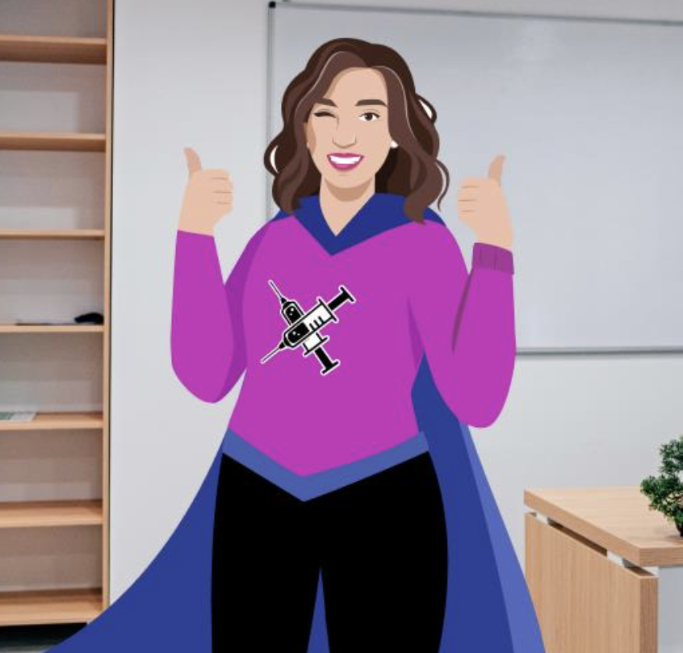
Becoming Immunization Champions
Your organization name
Instructors: See the notes section for more information.
Notes:
Thank you all for becoming Immunization Champions and helping to keep our students safe from preventable diseases.
These slides will emphasize what is covered in the immunization trainings posted at the Shots for Schools website- these modules should also be viewed by all staff tasked with checking and documenting immunizations required for school entry.

Slide 3
It’s the Law
Check student immunization records and ensure they meet requirements before school starts.
Your organization name
Instructors: See the notes section for more information.
Notes:
Remind parents that this is a state law. It's your job to check and be in compliance with CA law. (Resource at the end of this presentation will help you communicate with parents.)
This poster can be displayed in your office or at the front desks of schools and enrollment sites. The file is available on the ShotsforSchool website. Printed copies may be available at some local health departments.

Slide 4
School Guide
Notes:
Quick reference.
The laws are summarized in the School Guide. You all have copies.
We'll be using different parts of this guide throughout this training:
Table with requirements
Footnotes
Definitions
Conditional Admission table

Slide 5
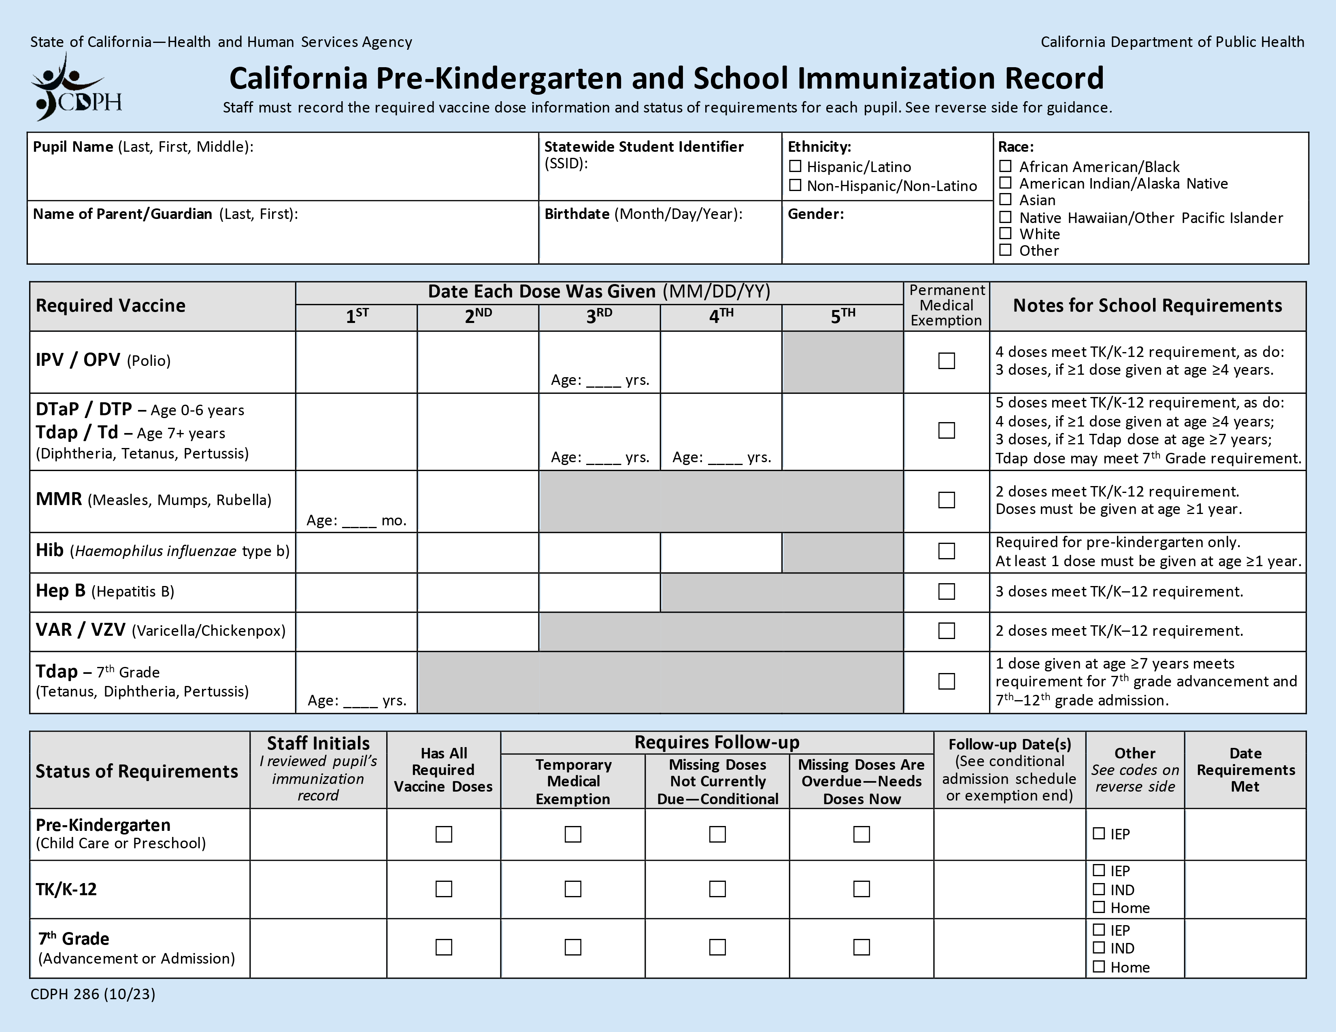
Blue Card
Notes:
Quick reference.
You all also have copies of the California Pre-K and School Immunization Record, also known as the Blue Card.
The requirements are also summarized in the Notes section of the Blue Card. We'll refer to these as we go through a few student scenarios.
Some of your schools may have Student Immunization Information Systems, but for the purpose of this training we're going to use the paper Blue Cards to create records.

Slide 6
Steps for Processing Records
Ask for child’s immunization record.
Transfer dates for doses to a Blue Card.
Determine if requirements are met.
Can the student be admitted to school?
Complete Status of Requirements section.
Notes:
These are the four basic steps to processing immunization records

Slide 7
Can a Student Attend School?
Unconditional Admission
Has all required doses OR
Permanent medical exemption (PME) for missing doses OR
Other: Alternative School programs (IND, IEP, Home)
Conditional Admission
Temporary medical exemption (TME) for missing doses OR
Missing doses are not due yet and has at least 1 dose of every required vaccine
X
Do Not Admit
Missing doses are overdue
Notes:
Note to instructor: "Conditional Admission" and "Do Not Admit" sections are timed to appear when you click the mouse.
It is your job to determine which category students fall under and if they can attend school or not. There are six categories under which students can fall and here they are:
Unconditional Admission means that students have met all requirements and can attend school.
Has all required doses OR
Permanent medical exemption (PME) for missing doses
Other: Alternative School programs (IND, IEP, Home). Students in home-based private schools or independent study programs who do not receive classroom-based instruction are not subject to the requirements. Also, students should receive services identified in their individualized education program (IEP) regardless of their immunization status. You'll still keep a Blue Card for these students with any immunization information they provide.
Conditional Admission means that students may attend school on the condition they get the remaining doses when they are due.
Temporary medical exemption (TME) for missing doses OR
Missing doses are not due yet (has at least 1 dose of every required vaccine)
Students may not be admitted to school if they are in this last category...
Missing doses are overdue

Slide 8
Let’s Practice
7th Grade and Higher
August 15, 2024
Notes:
Let's practice going through the steps and determining which category each student falls under and if they may be admitted to school.​
For the purposes of these exercises, school begins on August 15, 2024.
Note to instructor: If you have a group of mixed grade levels, you can replace some of the 7th grade scenarios with the equivalent TK/Kindergarten scenarios for the other slide set.

Slide 9
7th Grade Entry
7th – 12th Grade Admission: (attending the school for the first time) check all required immunizations
7th Grade Advancement: (advancing to 7th grade within the same school or school district) check Tdap and varicella vaccines
Notes:
Let’s refer to the School Guide again to check what the requirements are for 7th graders.
7th – 12th Grade Admission
This applies to students who are attending the school for the first time in these grades. All required immunizations need to be checked.
7th Grade Advancement
This typically applies to students advancing to 7th grade within the same school or school district that they attended for 6th grade.
Typically, these students have already met the K-12 admission requirements at earlier grades, except for 1 dose of Tdap. You’ll usually only need to check for 1 dose of Tdap and 2 doses of varicella vaccine.

Slide 10
Student 6
7th Grade Advancement
Notes:
Student 6 is advancing to 7th grade within the same school district.
What vaccines are we checking for?
Just 1 Tdap and 2 varicella doses.

Slide 11
Student 6 Blue Card
Six, Student
123456789
X
Six, Parent
10/24/2011
Female
X
01/27/12
05/26/12
05/05/13
08/05/16
12/19/11
02/25/12
05/26/12
05/05/13
08/05/16
01/26/13
08/05/16
15
12/19/11
02/25/12
05/26/12
11/08/12
10/24/11
11/21/11
07/27/12
01/26/13
08/05/16
NN
X
08/22/16
Instructors: See the notes section for more information.
Notes:
Student 6 was previously admitted unconditionally at kindergarten. Her parents supplied her Blue Card and an updated immunization record.

Slide 12
Student 6: 7th Grade Advancement
01/27/12
05/26/12
05/05/13
08/05/16
12/19/11
02/25/12
05/26/12
05/05/13
08/05/16
01/26/13
08/05/16
15
12/19/11
02/25/12
05/26/12
11/08/12
10/24/11
11/21/11
07/27/12
01/26/13
08/05/16
Instructors: See the notes section for more information.
Notes:
Now we are checking the requirements for 7th grade.
2 MMR: requirements were already met at TK admission. He has 2 doses, one of them was given after age 1.
1 Tdap: his Blue Card does not include Tdap, so we’ll have to check his immunization record.

Slide 13
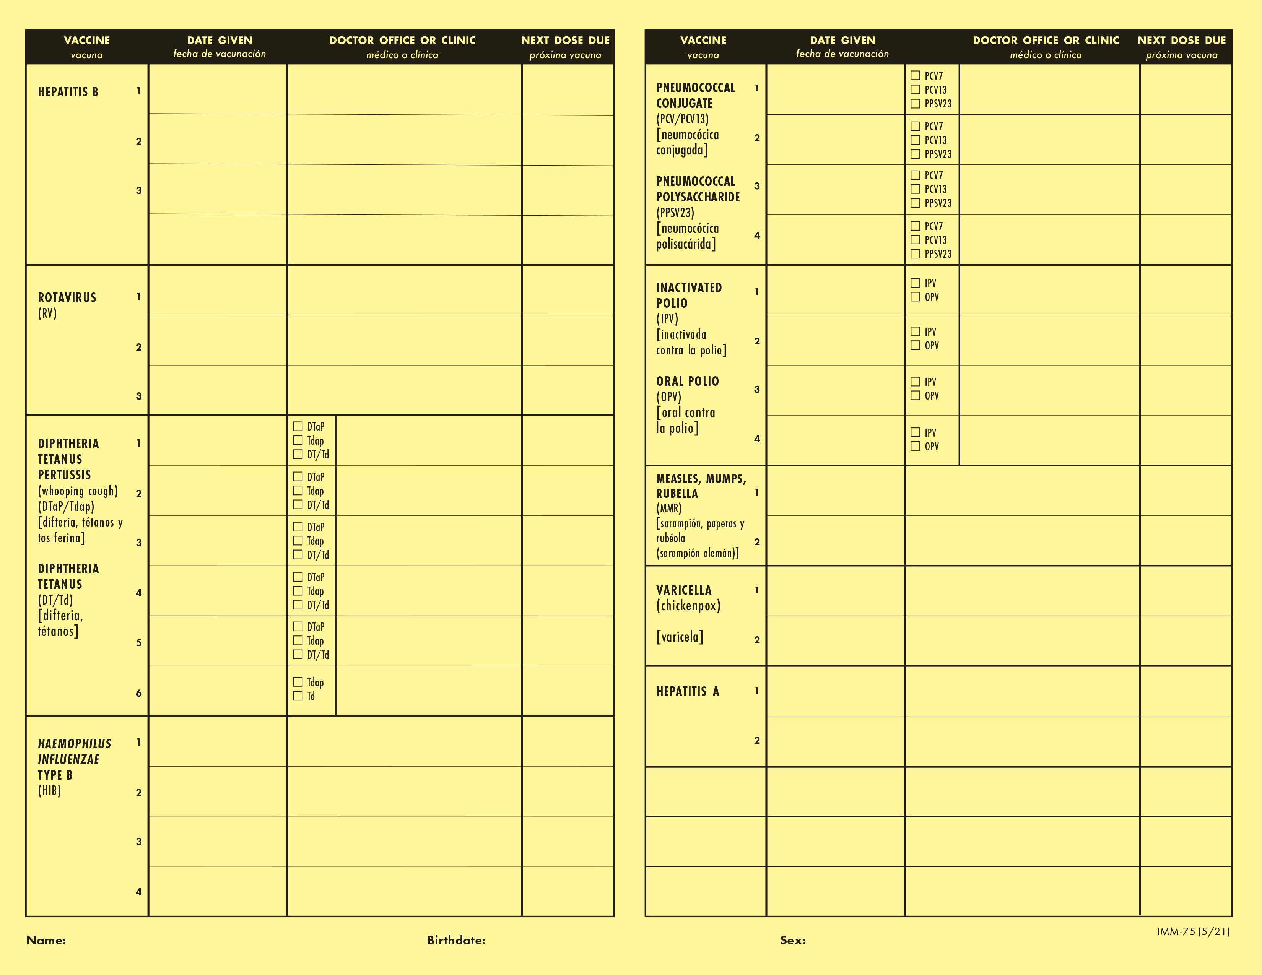
Student 6: Immunization Record
10/24/11
Happy Pediatrics
12/19/11
Happy Pediatrics
11/21/11
Happy Pediatrics
02/25/12
Happy Pediatrics
07/27/12
Happy Pediatrics
07/27/12
Happy Pediatrics
11/08/12
Happy Pediatrics
01/27/12
Happy Pediatrics
05/26/12
Happy Pediatrics
05/05/13
Happy Pediatrics
12/19/11
x
Happy Pediatrics
08/05/16
Happy Pediatrics
02/25/12
x
Happy Pediatrics
01/26/13
Happy Pediatrics
05/26/12
x
Happy Pediatrics
08/05/16
Happy Pediatrics
05/05/13
x
Happy Pediatrics
01/26/13
Happy Pediatrics
08/05/16
x
08/05/16
Happy Pediatrics
Happy Pediatrics
11/21/22
x
Happy Pediatrics
10/24/13
Happy Pediatrics
Instructors: See the notes section for more information.
Notes:
Can you find the Tdap vaccine on the record? …
It’s grouped with the Diphtheria, Tetanus, Pertussis vaccines on the bottom left.

Slide 14
Student 6: Immunization Record Close-Up
12/19/11
x
Happy Pediatrics
02/25/12
x
Happy Pediatrics
05/26/12
x
Happy Pediatrics
x
05/05/13
Happy Pediatrics
x
08/05/16
Happy Pediatrics
11/21/22
x
Happy Pediatrics
Instructors: See the notes section for more information.
Notes:
Let’s take a closer look.
Tdap is checked off, given on November 21, 2022.

Slide 15
Student 6: Update Blue Card
01/27/12
05/26/12
05/05/13
08/05/16
12/19/11
02/25/12
05/26/12
05/05/13
08/05/16
01/26/13
08/05/16
15
12/19/11
02/25/12
05/26/12
11/08/12
10/24/11
11/21/11
07/27/12
01/26/13
08/05/16
11/21/22 11
Instructors: See the notes section for more information.
Notes:
Let’s fill out the date for the Tdap vaccine and calculate the age she was at the time. She was 11 years old.
See notes section on Blue card: 1 Tdap administered at 7 years or older meets the requirement.

Slide 16
Has All Required Vaccine Doses: Unconditional
Seven, Student
123456789
X
Seven, Parent
10/24/2011
Male
X
01/27/12
05/26/12
05/05/13
08/05/16
12/19/11
02/25/12
05/26/12
05/05/13
08/05/16
01/26/13
08/05/16
15
12/19/11
02/25/12
05/26/12
11/08/12
10/24/11
11/21/11
07/27/12
01/26/13
08/05/16
11/21/22 11
NN
X
08/22/16
NN
X
08/15/24
Instructors: See the notes section for more information.
Notes:
Student 6 can be admitted unconditionally to 7th grade.

Slide 17
Student 7
7th Grade Admission
Notes:
Student 7 is transferring from another school district.
What vaccines are we checking for? Refer to your School Guide…
All required vaccines for K-12th grade.

Slide 18
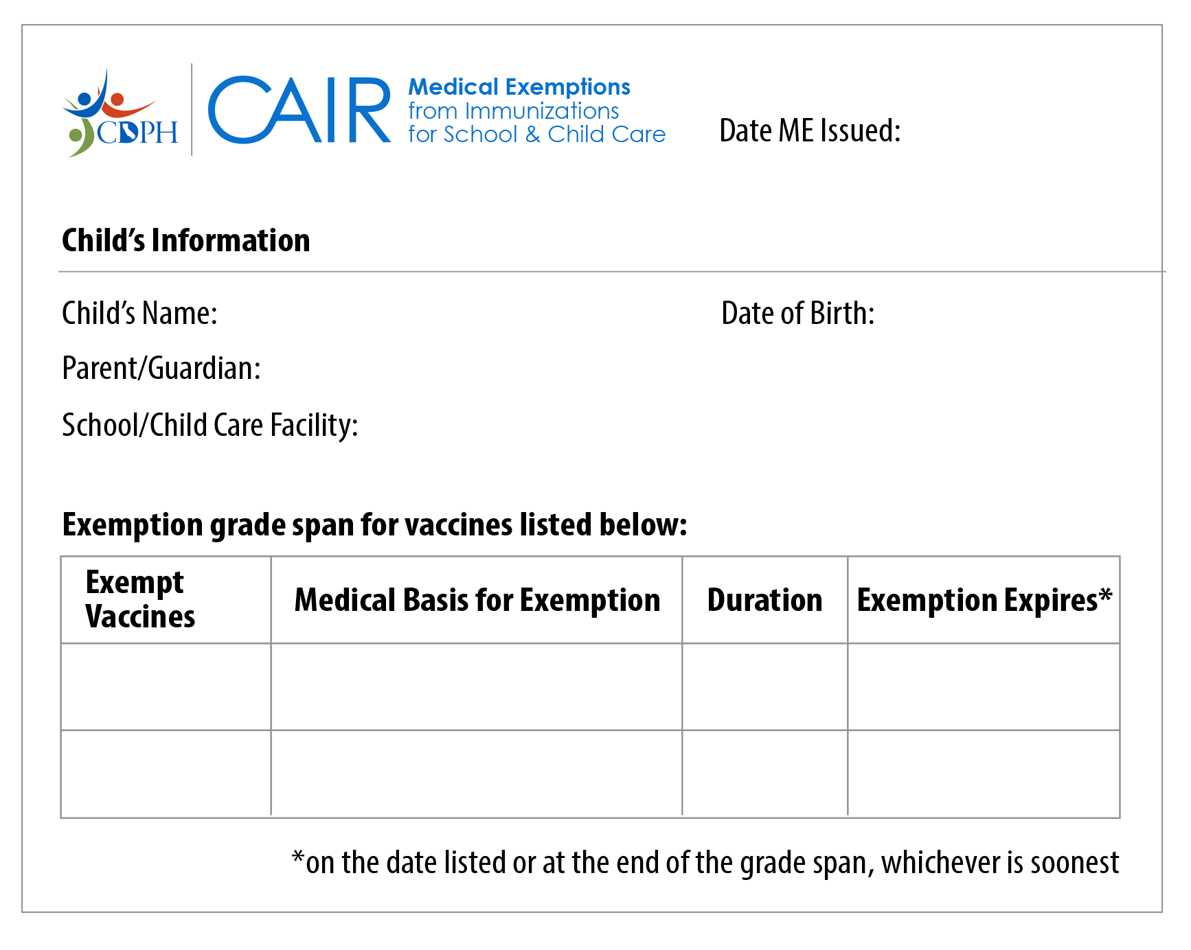
Student 7 (PME)
Permanent Medical Exemption
08/15/24
Student Seven
10/10/2012
Parent Seven
Champions Middle School
7th – 12th Grade
Varicella
History of disease
Permanent
End of 12th grade
Instructors: See the notes section for more information.
Notes:
The parents have supplied a medical exemption.
As of January 1, 2021, all new exemptions must be issued from the CAIR-ME website.
This is a representation of a Permanent Medical Exemption (PME) from CAIR-ME, not an exact copy.
Things to check for a valid PME:
Issue date
Child’s information
School’s information
Grade span
Exempt vaccines and expiration.
Use this name and birth date to fill out the Blue Card (since it will not be shown on the immunization record on next slide).

Slide 19
Student 7: Immunization Record (page 1)
GROUP grupo | SERIES serie | DATE GIVEN fecha de vacunación | AGE GIVEN edad de vacunación | VACCINE Vacuna | CLINIC ADMINISTERED OR TRANSCRIBED administrada o transcrita en la clinica
COVID | 1 of 3 | 12/01/21 | 8yrs 11mo 22d | Pfizer Pediatric COVID-19 | La Clinica de la Raza
COVID | 2 of 3 | 11/19/22 | 9yrs 11mo 9d | Pfizer Pediatric COVID-19 | La Clinica de la Raza
COVID | 3 of 3 | 08/30/23 | 10yrs 8mo 20d | Pfizer Pediatric COVID-19 | La Clinica de la Raza
DTaP | 1 of 5 | 12/23/12 | 0yrs 2mo 13d | Pediarix | La Clinica de la Raza
DTaP | 2 of 5 | 02/19/13 | 0yrs 4mo 9d | Pediarix | La Clinica de la Raza
DTaP | 3 of 5 | 04/11/13 | 0yrs 6mo 1d | Pediarix | La Clinica de la Raza
DTaP | 4 of 5 | 03/20/14 | 1yrs 5mo 10d | Brand not specified | La Clinica de la Raza
DTaP | 5 of 5 | 08/10/17 | 4yrs 10mo 0d | Kinrix | La Clinica de la Raza
Hep A | 1 of 2 | 10/23/20 | 1yrs 0mo 13d | Vaqta | La Clinica de la Raza
Hep A | 2 of 2 | 08/19/21 | 1yrs 10mo 9d | Vaqta | La Clinica de la Raza
Hep B | 1 of 3 | 12/23/12 | 0yrs 2mo 13d | Pediarix | La Clinica de la Raza
Hep B | 2 of 3 | 02/19/13 | 0yrs 4mo 9d | Pediarix | La Clinica de la Raza
Hep B | 3 of 3 | 04/11/13 | 0yrs 6mo 1d | Pediarix | La Clinica de la Raza
Instructors: See the notes section for more information.
Notes:
This is page one of a cropped sample record from the California Immunization Registry.
Transfer the dates to the Blue Card.

Slide 20
Student 7: Immunization Record (page 2)
GROUP grupo | SERIES serie | DATE GIVEN fecha de vacunación | AGE GIVEN edad de vacunación | VACCINE Vacuna | CLINIC ADMINISTERED OR TRANSCRIBED administrada o transcrita en la clinica
MMR | 1 of 3 | 10/23/13 | 1yrs 0mo 13d | Proquad | La Clinica de la Raza
MMR | 2 of 2 | 08/10/17 | 4yrs 10mo 0d | Proquad | La Clinica de la Raza
PCV | 1 of 4 | 12/23/12 | 0yrs 2mo 13d | Prevnar 13 | La Clinica de la Raza
PCV | 2 of 4 | 02/19/13 | 0yrs 4mo 9d | Prevnar 13 | La Clinica de la Raza
PCV | 3 of 4 | 04/11/13 | 0yrs 6mo 1d | Prevnar 13 | La Clinica de la Raza
PCV | 4 of 4 | 10/23/13 | 1yrs 0mo 13d | Prevnar 13 | La Clinica de la Raza
Polio | 1 of 4 | 12/23/12 | 0yrs 2mo 13d | Brand not specified | La Clinica de la Raza
Polio | 2 of 4 | 02/19/13 | 0yrs 4mo 9d | Kinrix | La Clinica de la Raza
Polio | 3 of 4 | 04/11/13 | 0yrs 6mo 1d | Vaqta | La Clinica de la Raza
Polio | 4 of 4 | 08/10/17 | 4yrs 10mo 0d | Vaqta | La Clinica de la Raza
RV | 1 of 3 | 12/23/12 | 0yrs 2mo 13d | Rotarix | La Clinica de la Raza
RV | 2 of 3 | 02/19/13 | 0yrs 4mo 9d | Rotarix | La Clinica de la Raza
Tdap | 1 of 1 | 08/30/23 | 10yrs 10mo 20d | Boostrix | La Clinica de la Raza
Flu |  | 10/30/23 | 11yrs 0mo 20d | Brand not specified | La Clinica de la Raza
Instructors: See the notes section for more information.
Notes:
This is page 2.
Transfer the dates for the remaining immunizations from page 2 of the record.

Slide 21
Student 7: Check Requirements
12/23/12
02/19/13
04/11/13
08/10/17
12/23/12
02/19/13
04/11/13
03/20/14
08/10/17
10/23/13 12
08/10/17
12/23/12
02/19/13
04/11/13
08/30/23
10
Missing varicella doses
Instructors: See the notes section for more information.
Notes:
After filling out all of the dates, we see that this student is missing varicella doses but has all the other required vaccines.
Remember the PME that was issued? This student is exempt from varicella.

Slide 22
PME + All Other Doses: Unconditional
Eight, Student
123456789
X
Eight, Parent
10/10/2012
Female
X
12/23/12
02/19/13
04/11/13
08/10/17
12/23/12
02/19/13
04/11/13
03/20/14
08/10/17
10/23/13 12
08/10/17
10/10/12
12/23/13
04/11/13
X
08/30/23
10
NN
08/22/17
NN
08/22/24
Instructors: See the notes section for more information.
Notes:
The PME meets the requirements for the missing varicella doses and the student has all other required doses. This student may be admitted unconditionally.
Add an “x” in the PME column for varicella
In the Status of Requirements section, add your initials, do not mark “Has All Required Vaccine Doses” because the student is missing varicella. Add the date.
Student 7 may be admitted unconditionally. Unconditional admission means no follow-up is required. They’re done unless their exemption is revoked.

Slide 23
Student 8
8th Grade Admission
Notes:
Note to instructor: Students 8 and 9 will be using the same basic immunization history (both missing doses, but one with a TME and one without). For a more complex conditional admission example, participants can be referred to K-12 training modules.
Student 8 is transferring from a different state for 8th grade.
What vaccines are we checking for?
All the vaccines required for K-12th grade.

Slide 24
Student 8 (TME)
Temporary Medical Exemption
08/15/24
Student Eight
02/11/2011
Parent Eight
Champions Middle School
7th-12th Grade
Varicella
Immunocompromised
Temporary
12/15/24
Instructors: See the notes section for more information.
Notes:
This student is registering for 8th grade and has a medical exemption issued from CAIR-ME. We can see that it is a temporary medical exemption or TME.
The student is exempt from varicella vaccine until the expiration date.
Please make a note of this expiration date as you’ll need it for following up for continued attendance.

Slide 25
Student 8 (Immunization Record page 1)
Name: Student Eight | DOB: 2/11/2011 | MRN:1234567 | PCP: Becca Monte, MD
Current Immunizations
COVID-19 Vaccine
Dates on file: 11/05/2022, 06/07/2022, 12/04/2021, 11/11/2021
Diphtheria, Tetanus, Pertussis (DTaP) Vaccine
Dates on file: 02/27/2017, 05/15/2012, 08/29/2011, 06/24/2011, 04/19/2011
Flu Vaccine
Dates on file: 10/27/2023, 10/17/2022, 10/28/2021,
10/10/2020
Haemophilus influenza type B (HIB) Vaccine
Dates on file: 05/15/2012, 09/29/11
Hepatitis A Vaccine
Dates on file: 08/21/2012, 02/22/2012
Hepatitis B Vaccine
Dates on file: 10/25/2011, 03/15/2011, 02/12/2011
Instructors: See the notes section for more information.
Notes:
Sample record from Electronic Health Record (EHR).
Transfer the dates for doses to the Blue Card.
Note that the dates go in order of most recent first.

Slide 26
Student 8 (Immunization Record page 2)
Measles, Mumps, Rubella (MMR) Vaccine
Dates on file: 12/30/2015, 02/14/2012
Pneumonia Vaccine (pneumococcal)
Dates on file: 02/14/2012, 08/29/2011, 06/24/2011, 04/19/2011
Polio (IPV) Vaccine
Dates on file: 05/15/2012, 08/29/2011, 06/24/2011, 04/19/2011
Rotavirus Vaccine
Dates on file: 08/29/2011, 06/24/2011, 04/19/2011
Tetanus, Diphtheria, Pertussis, Vaccine
Dates on file: 07/01/2024
Varicella (Chickenpox) Vaccine
Dates on file: 07/01/2024
Instructors: See the notes section for more information.
Notes:
Now, transfer the dates for required doses on page 2.

Slide 27
Student 8: Check Requirements
04/19/11
06/24/11
08/29/11
05/15/12
04/19/11
06/24/11
08/29/11
05/15/12
02/27/17
02/14/12 12
12/30/15
09/29/11
05/15/12
02/12/11
03/15/11
10/25/11
07/01/24
07/01/24 13
Missing varicella #2
Instructors: See the notes section for more information.
Notes:
After filling out all of the dates, we see that the student is missing:
2nd dose of varicella
They have all the other required vaccines.

Slide 28
TME + All Other Doses: Conditional
Eight, Student
123456789
X
Eight, Parent
02/11/2011
Female
X
Deadline
Varicella #2
12/15/24
Follow-Up
11/15/24
04/19/11
06/24/11
08/29/11
05/15/12
04/19/11
06/24/11
08/29/11
05/15/12
02/27/17
02/14/12
12/30/15
09/29/11
05/15/12
02/12/11
03/15/11
10/25/11
07/01/24
07/01/24 13
NN
X
11/15/24
Instructors: See the notes section for more information.
Notes:
Remember that this student has a TME for the missing dose and has all other required doses.
We'll process this student differently than the Permanent Medical Exemption scenario.
Student 8 may be admitted conditionally.
Follow-up is required before the TME expires.
We made a note of the exemption expiration date in December. This is the deadline.
It’s best to send a reminder about a month before the deadline. We'll show you how to do this with the next student.
In the Status of Requirements section:
Add your initials, and mark “Temporary Medical Exemption”.
Add the follow-up date.
Parents will need to show proof of receiving the missing doses or a new TME before the expiration date for the student to continue to attend school.

Slide 29
Student 9
8th Grade Admission
Notes:
Student 9 is also transferring to the 8th grade from another state.
What vaccines are we checking for?
All required doses for K-12.

Slide 30
Student 9: Missing Doses, No TME
04/19/11
02/27/24
04/19/11
06/24/11
08/29/11
05/15/12
02/27/17
02/14/12 12
12/30/15
09/29/11
05/15/12
02/12/11
03/15/11
10/25/11
07/01/24
07/01/24 13
Missing polio doses and varicella #2
Instructors: See the notes section for more information.
Notes:
For Student 9, let’s re-use the same record as Student 8 with a few changes.
No TME and
Change their Blue Card to show only two doses of polio vaccine. 2nd dose given in Feb 2024.
All the other dates are filled out the same way as before with missing dose for varicella.
At first glance it looks like Student 9 needs two more doses of polio, but we see in the Notes section, that they only need 3 doses if one is given on or after the 4th birthday which is the case here. The 2nd dose was given recently, around age 13.

Slide 31
Student 9: Deadline for Polio
Footnote 1:
Only 3 doses of polio needed if 1 dose was on or after 4th birthday
Final dose: give at least 6 months after the 2nd dose
Instructors: See the notes section for more information.
Notes:
Let's look at the Conditional Admission Schedule for Polio #3, footnote #1 before setting the deadline.
In this case, the 3rd dose of polio will be the final dose and
must be given at least 6 months after the 2nd dose AND no later than 12 month after the 2nd dose. (Refer to Exclude If Not Given By column.)

Slide 32
Student 9: Check Due Date
Polio #2: 2/27/24
Polio #3:
Deadline: 2/27/25
Varicella #2:
Deadline: 8/26/24
12 months
Varicella #1: 7/1/24
8 weeks
Instructors: See the notes section for more information.
Notes:
So let's figure out the deadline date for Polio #3. Checking the Blue Card:
Polio #2 was given on Feb 27, 2024. Polio #3 is due 12 months later which is February 27, 2025. So the deadline for Polio #3 is not until next year.
Varicella #2 is due 8 weeks after the 1st dose.
Varicella #1 was given on July 1, 2024. Varicella #2 is due 8 weeks later which is August 26, 2024. So, the deadline for varicella #2 has not passed yet.
Both doses are not due before school starts on August 15, 2024.
Can this child be admitted to school?
Yes, since the missing doses are not due before school starts, Student 9 may be admitted conditionally. They may attend school on the “condition” that the receive the missing doses by the deadline.
Now let’s try to figure out when the best follow-up date is.

Slide 33
Student 9: Earliest Dose May Be Given
Polio Footnote 1:
Final dose: give at least 6 months after the 2nd dose
Instructors: See the notes section for more information.
Notes:
Usually, we start sending reminders at least 1 month before the deadline. But for deadlines several months away, you can also use the timing under the Earliest Dose May Be Given column to start sending reminders.
Before we do that, let's take a look at footnote #1 again, for Polio #3 on the Conditional Admission Schedule. The footnote states that the earliest this final dose can be given is 6 months after the 2nd dose.
Varicella #2 can be given as early as 4 weeks after the first dose.

Slide 34
Student 9: Set Follow-Up Date
Polio #3:
Deadline: 2/27/25 Reminder: 8/27/24
Varicella #2:
Deadline: 8/26/24 Reminder: 7/29/24
Polio #2: 2/27/24
6-11 months
Varicella #1: 7/1/24
4 weeks
Instructors: See the notes section for more information.
Notes:
Now let's apply this information to set follow-up dates for Student 9.
Polio # 3: Based on the footnote from the Conditional Admission Schedule, you could start sending a reminder as early as 6 months after the 2nd dose (and up until the month before the deadline, 11 months after the 2nd dose). Let's use the 6-month date of August 27, 2024.
Varicella #2 can be given as early as 4 weeks after the first dose. That’s on July 29th, 4 weeks before the deadline.
Use the earlier follow-up date (circled) to send a reminder to parents about the deadlines for both vaccines.

Slide 35
Missing Doses Not Due: Conditional
Nine, Student
123456789
X
X
Nine, Parent
02/11/2011
Male
Polio #3:
Deadline: 2/27/25 Reminder: 8/27/24
Varicella #2:
Deadline: 8/26/24 Reminder: 7/29/24
04/19/11
02/27/24
04/19/11
06/24/11
08/29/11
05/15/12
02/27/17
02/14/12
12/30/15
09/29/11
05/15/12
02/12/11
03/15/11
10/25/11
07/01/24
07/01/24 13
NN
X
07/29/24
Instructors: See the notes section for more information.
Notes:
Since we determined the missing doses are not due yet, Student 9 may be admitted conditionally. Mark the Missing Doses Not Currently Due column and add the follow-up date for when you will send a reminder.
Note to instructor: Participants can cross out prior status to conserve Blue Cards.

Slide 36
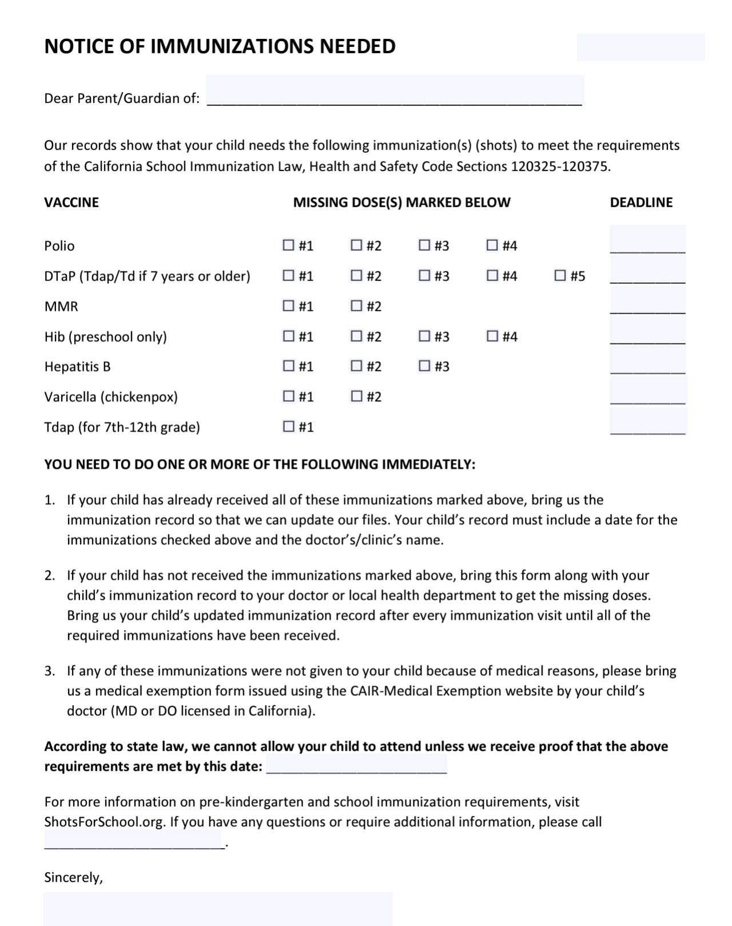
Send a Reminder
7/29/24
Student Nine
X
02/27/25
Polio #3:
Deadline: 2/27/25 Reminder: 8/27/24
Varicella #2:
Deadline: 8/26/24 Reminder: 7/29/24
X
09/24/24
08/26/24
1-888-867-5309
Your Name
Instructors: See the notes section for more information.
Notes:
When it's time to follow-up, fill out a Notice of Immunizations Needed letter and send it to parents. This template can be downloaded in multiple languages from the Shots for School website.
Write in the deadline date that we already calculated on the sticky note—next to the missing vaccine. At the bottom where it states that "according to state law, we cannot allow your child to attend unless we receive proof that the above requirements are met by this date… write in the earliest deadline date.”

Slide 37
Receive Next Doses: Conditional
Nine, Student
123456789
X
X
Nine, Parent
02/11/2011
Male
Polio #3:
Deadline: 2/27/25 Reminder: 8/27/24
Varicella #2:
Deadline: 8/26/24 Reminder: 7/29/24
04/19/11
07/01/24
04/19/11
06/24/11
08/29/11
05/15/12
02/27/17
02/14/12
12/30/15
09/29/11
05/15/12
02/12/11
03/15/11
10/25/11
07/01/24
08/24/24
07/01/24 13
NN
X
10/01/24 08/27/24
Instructors: See the notes section for more information.
Notes:
When you receive an updated immunization record, fill in the missing doses on the Blue Card.
If, for example, because of the notice you sent, you received an updated immunization record showing the student received a dose of varicella vaccine on August 24, 2024:
Add the date for varicella #2. Now, that vaccine requirement has been met
Still missing polio #3, but the deadline has not passed yet.
They may attend school conditionally until the deadline for polio #3.
Update the Status of Requirements section by crossing out the Follow-Up Date and adding a new date for sending another reminder for polio #3.

Slide 38
Receive Final Doses: Unconditional
Nine, Student
123456789
X
X
Nine, Parent
02/11/2011
Male
04/19/11
07/01/24
02/01/25 13
04/19/11
06/24/11
08/29/11
05/15/12
02/27/17
02/14/12
12/30/15
09/29/11
05/15/12
02/12/11
03/15/11
10/25/11
07/01/24
08/24/24
07/01/24 13
NN
X
X
10/01/24 08/27/24
02/01/25
Instructors: See the notes section for more information.
Notes:
After sending the reminder notice, you received an updated immunization record showing the student received a dose of polio on February 1, 2025
Add the date for polio #3 and age. Next, take a look at the Notes section. Remember that 3 doses meet the requirement if at least one dose was given at 4 years of age or older. This is the case for our student, so the polio requirement is met. Requirements were already met for all other vaccine doses.
Student 9's status now changes to unconditional. They may attend school with no further follow-up.
Update the Status of Requirements section by crossing out the “x” in the Missing Doses Not Currently Due column and the Follow-Up Date.
Put an "x" in the Has All Required Vaccine Doses column and add the date when you received the updated records and requirements were met.

Slide 39
Student 10
7th Grade Advancement
Notes:
Student advancing to 7th grade within the same school. School just started up this week and you’re not sure all the records were checked for the continuing students who were in 6th grade last year.
What immunizations are you checking for?
2 varicella and 1 Tdap.

Slide 40
Student 10 Blue Card
Ten, Student
123456789
X
X
Ten, Parent
11/26/2011
Female
X
01/26/12
03/23/12
05/17/12
02/27/16
01/26/12
03/23/12
05/17/12
02/27/16 4
11/29/12 12
08/15/19
01/26/12
03/23/12
05/17/12
06/29/13
01/26/12
03/23/12
05/17/12
11/29/12
08/15/19
NN
X
X
08/16/19
Instructors: See the notes section for more information.
Notes:
Student 10 was previously admitted unconditionally at third grade. You already have her Blue Card on file.

Slide 41
Student 10: Check Requirements
01/26/12
03/23/12
05/17/12
02/27/16
01/26/12
03/23/12
05/17/12
02/27/16 4
11/29/1212
08/15/19
01/26/12
03/23/12
05/17/12
06/29/13
01/26/12
03/23/12
05/17/12
11/29/12
08/15/19
Missing Tdap vaccine
Instructors: See the notes section for more information.
Notes:
Let’s take a closer look at the Blue Card for Student 10 and reference the School Guide for 7th Grade Advancement.
What vaccine is she missing?
Just Tdap.
Note for instructor: click to make the answer appear.

Slide 42
Missing Doses Overdue: Don’t Admit
X
Ten, Student
123456789
X
X
Ten, Parent
11/26/2011
Female
X
01/26/12
03/23/12
05/17/12
02/27/16
01/26/12
03/23/12
05/17/12
02/27/16 4
11/29/12 12
08/15/19
01/26/12
03/23/12
05/17/12
06/29/13
01/26/12
03/23/12
05/17/12
11/29/12
08/15/19
NN
X
X
08/16/19
NN
X
Instructors: See the notes section for more information.
Notes:
Can Student 10 be admitted to 7th grade?
No, this student cannot be admitted to school until they show proof of having received a dose of Tdap vaccine. They are currently not in compliance with CA law.
Fill out the Notice of Immunizations Needed letter and give it to the family to take to their doctor to receive the missing dose.
In the Status of Requirements section, add your initials, and mark “Missing Doses Are Overdue.”

Slide 43
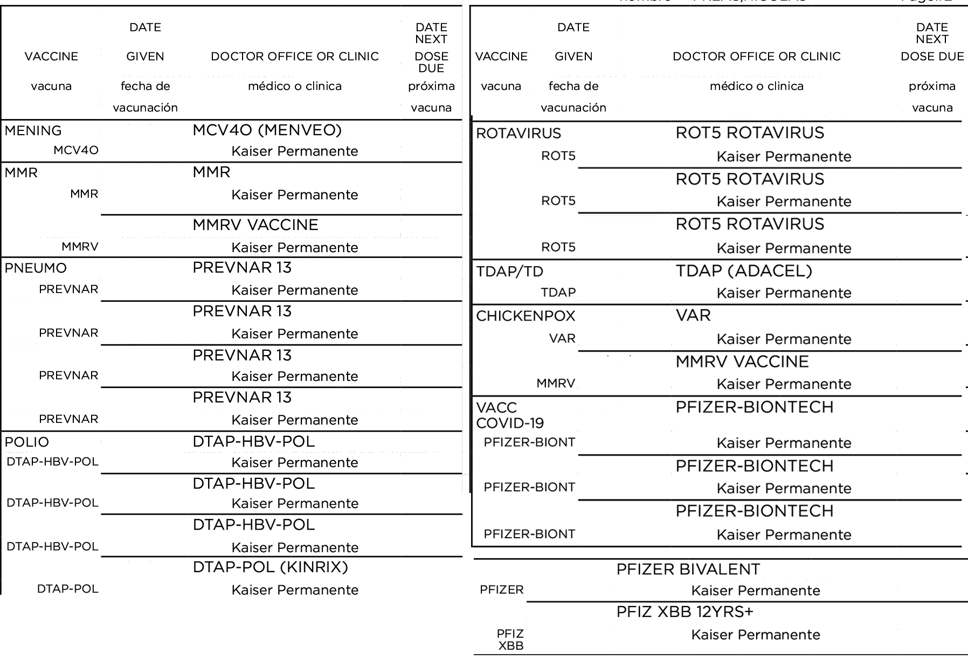
Student 10: Immunization Record (page 2)
Name nombre: Student Ten Birthdate: 11/26/2011 Kaiser MR:1234567 Printed: 08/14/24 Page 2
08/20/2024
01/26/2012
11/29/2012
03/23/2012
08/15/2019
05/17/2012
01/26/2012
08/20/2024
03/23/2012
11/29/2012
05/17/2012
08/15/2019
02/27/2016
11/11/2021
01/26/2012
12/03/2021
03/23/2012
05/17/2012
05/29/2022
02/27/2016
03/17/2023
03/15/2024
Instructors: See the notes section for more information.
Notes:
We received this updated record after sending the Notice of Immunizations Needed letter.
This is a close to real-life example of a record, showing that it can be confusing with combination vaccines, product brand names, and abbreviations. We’ll include a link at the end of the presentation to a guide that can help.
Notice that the combination vaccines are listed under all vaccine types included in the combination vaccine. For example, DTAP-HBV-POL combination vaccine is listed under DTP, Hep B and Polio vaccine sections.
Can you find the missing Tdap vaccine?
What’s the date and age that we should write on the Blue Card for when the dose was administered?

Slide 44
Proof of Missing Dose: Unconditional
Ten, Student
123456789
X
X
Ten, Parent
11/26/2011
Female
01/26/12
03/23/12
05/17/12
02/27/16
01/26/12
03/23/12
05/17/12
02/27/16 4
11/29/12 12
08/15/19
01/26/12
03/23/12
05/17/12
06/29/13
01/26/12
03/23/12
05/17/12
11/29/12
08/15/19
08/20/24 12
NN
X
X
08/16/19
NN
X
X
08/20/24
Instructors: See the notes section for more information.
Notes:
Under Tdap, we’ll write the date in the Tdap row: August 20, 2024. And age 12 for when the student was vaccinated.
Check the notes section to see if requirements are met.
Tdap: 1 dose give at age 7 or older meets the requirement
In the Status of Requirements section, cross out the “x” on the “Missing Doses Are Overdue” column.
Add an “x” to the Has All Required Vaccine Doses” column and the date you received the updated record.
Now Student 10 may be admitted unconditionally.

Slide 45
Additional Tips
Notes:
Now for a few more general items…

Slide 46
Roster of Students Missing Doses
If Missing Doses, Mark the Category (Reason)
Mark Missing Vaccines
# | Student | Has All Required Doses | PME | IEP | IND | Home | Condi-tional | TME | Overdue | Polio | DTaP | MMR | HepB | VAR | Tdap
1. | Student Seven |  | X |  |  |  |  |  |  |  |  |  |  | X
2. | Student Eight |  |  |  |  |  |  | X |  |  |  |  |  | X
3. | Student Nine |  |  |  |  |  | X |  |  | X |  |  |  | X | X
4.
5.
Instructors: See the notes section for more information.
Notes:
It's helpful to list all the students who are missing doses to have as an easy reference during outbreaks and Immunization Reporting to the California Department of Public Health (CDPH).
Remember the 6 categories we went over at the beginning when we were on slide 7? There's a column for each one on the Worksheet.
You'll need to report the number of 7th grade students in each of the 6 categories (just for varicella and Tdap) to CDPH in the fall.

Slide 47
Special Situations
Transfer students within U.S.:
May allow up to 30 school days for records to arrive
When records arrive, if missing doses: may allow up to 10-school day deadline
Students in foster care or experiencing homelessness:
Enroll immediately, even if immunization records are missing or unavailable. Follow up according to conditional admission schedule
18+ years old: Not subject to requirements
Instructors: See the notes section for more information.
Notes:
For transfer students:
If immunization record is not available at the time of admission, schools may admit for up to 30 school days while waiting for records to arrive from previous school.
After 30 school days, exclude the student until parents can submit documentation of required doses.
If you get the folder from the other school and see missing doses, you may allow up to 10 school days for parents to show those doses were given. Exclude the student after the deadline (no more than 10 school days).
For foster care and students experiencing homelessness:
Enroll students immediately, even if immunization records are missing or unavailable at the time of enrollment. They can typically be considered transfer students and so can have up to 30 school days to show proof of immunization. For homeless students, it's important for the homeless liaison to work with them immediately to help connect them with health care services and follow up according to the conditional admission schedule. Once records arrive, follow the normal process. Students who do not have proof of meeting the requirements are subject to exclusion until proof of immunizations are submitted.
For those 18+ years old:
These students are not subject to requirements. You can still recommend these students finish catching up on missing vaccines.

Slide 48
More Special Situations
Dose given too early:
If the dose date is before Earliest Dose May be Given date, the dose still counts.
Missing Hep B at 7th grade:
Students must complete the series after 7th grade:
when next considered to be an admission at 8th-12th grade OR
at 8th grade entry: if ever attended K in CA or were admitted to any grade except 7th at any time after 7/1/2019
OPV and international students:
Doses of OPV given on or after April 1, 2016, do not count. The student must show proof of IPV.
Instructors: See the notes section for more information.
Notes:
Note to instructor: these topics can be covered with more advanced groups or skipped for beginners.
Intervals too small (example: 3rd Hep B dose for student admitted conditionally was given too early): If a dose is given before the earliest dose may be given date on the conditional admission schedule, it still counts towards the requirement. See California Immunization Handbook pages 10-11 for additional details about which doses to check the timing of.
Missing dose of Hep B at 7th grade admission or advancement: After 7th grade, students are required to continue the series:
if and when next considered to be an admission at 8th-12th grade OR
at 8th grade entry: if ever attended K in CA or considered an admission to any grade except 7th at any time on or after 7/1/19.
Students would follow the conditional admission schedule until the series is complete.
For international students, any doses of OPV given on or after April 1, 2016, do not count. The student must show proof of IPV. Referenced on pages 9 and 11 of the CA Immunization Handbook.

Slide 49
ShotsForSchool.org
Instructors: See the notes section for more information.
Notes:
You can find all the resources that we used in this training and more on the Shots For School website.
Most can be found by selecting the Tools for Schools section in the navigation, and the Guides, Blue Cards & More section.

Slide 50
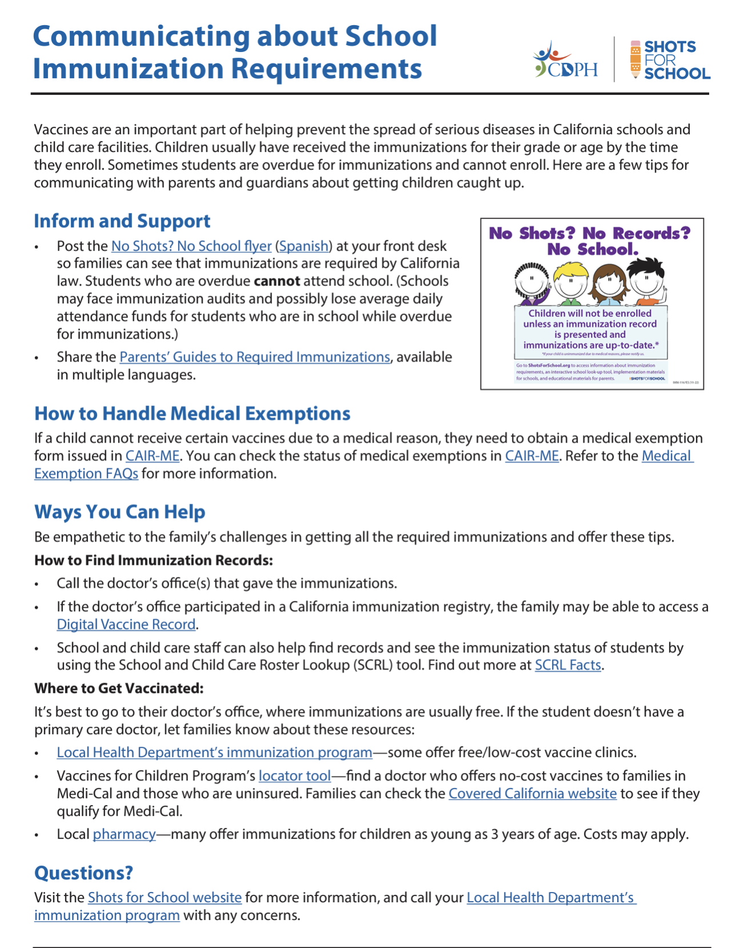
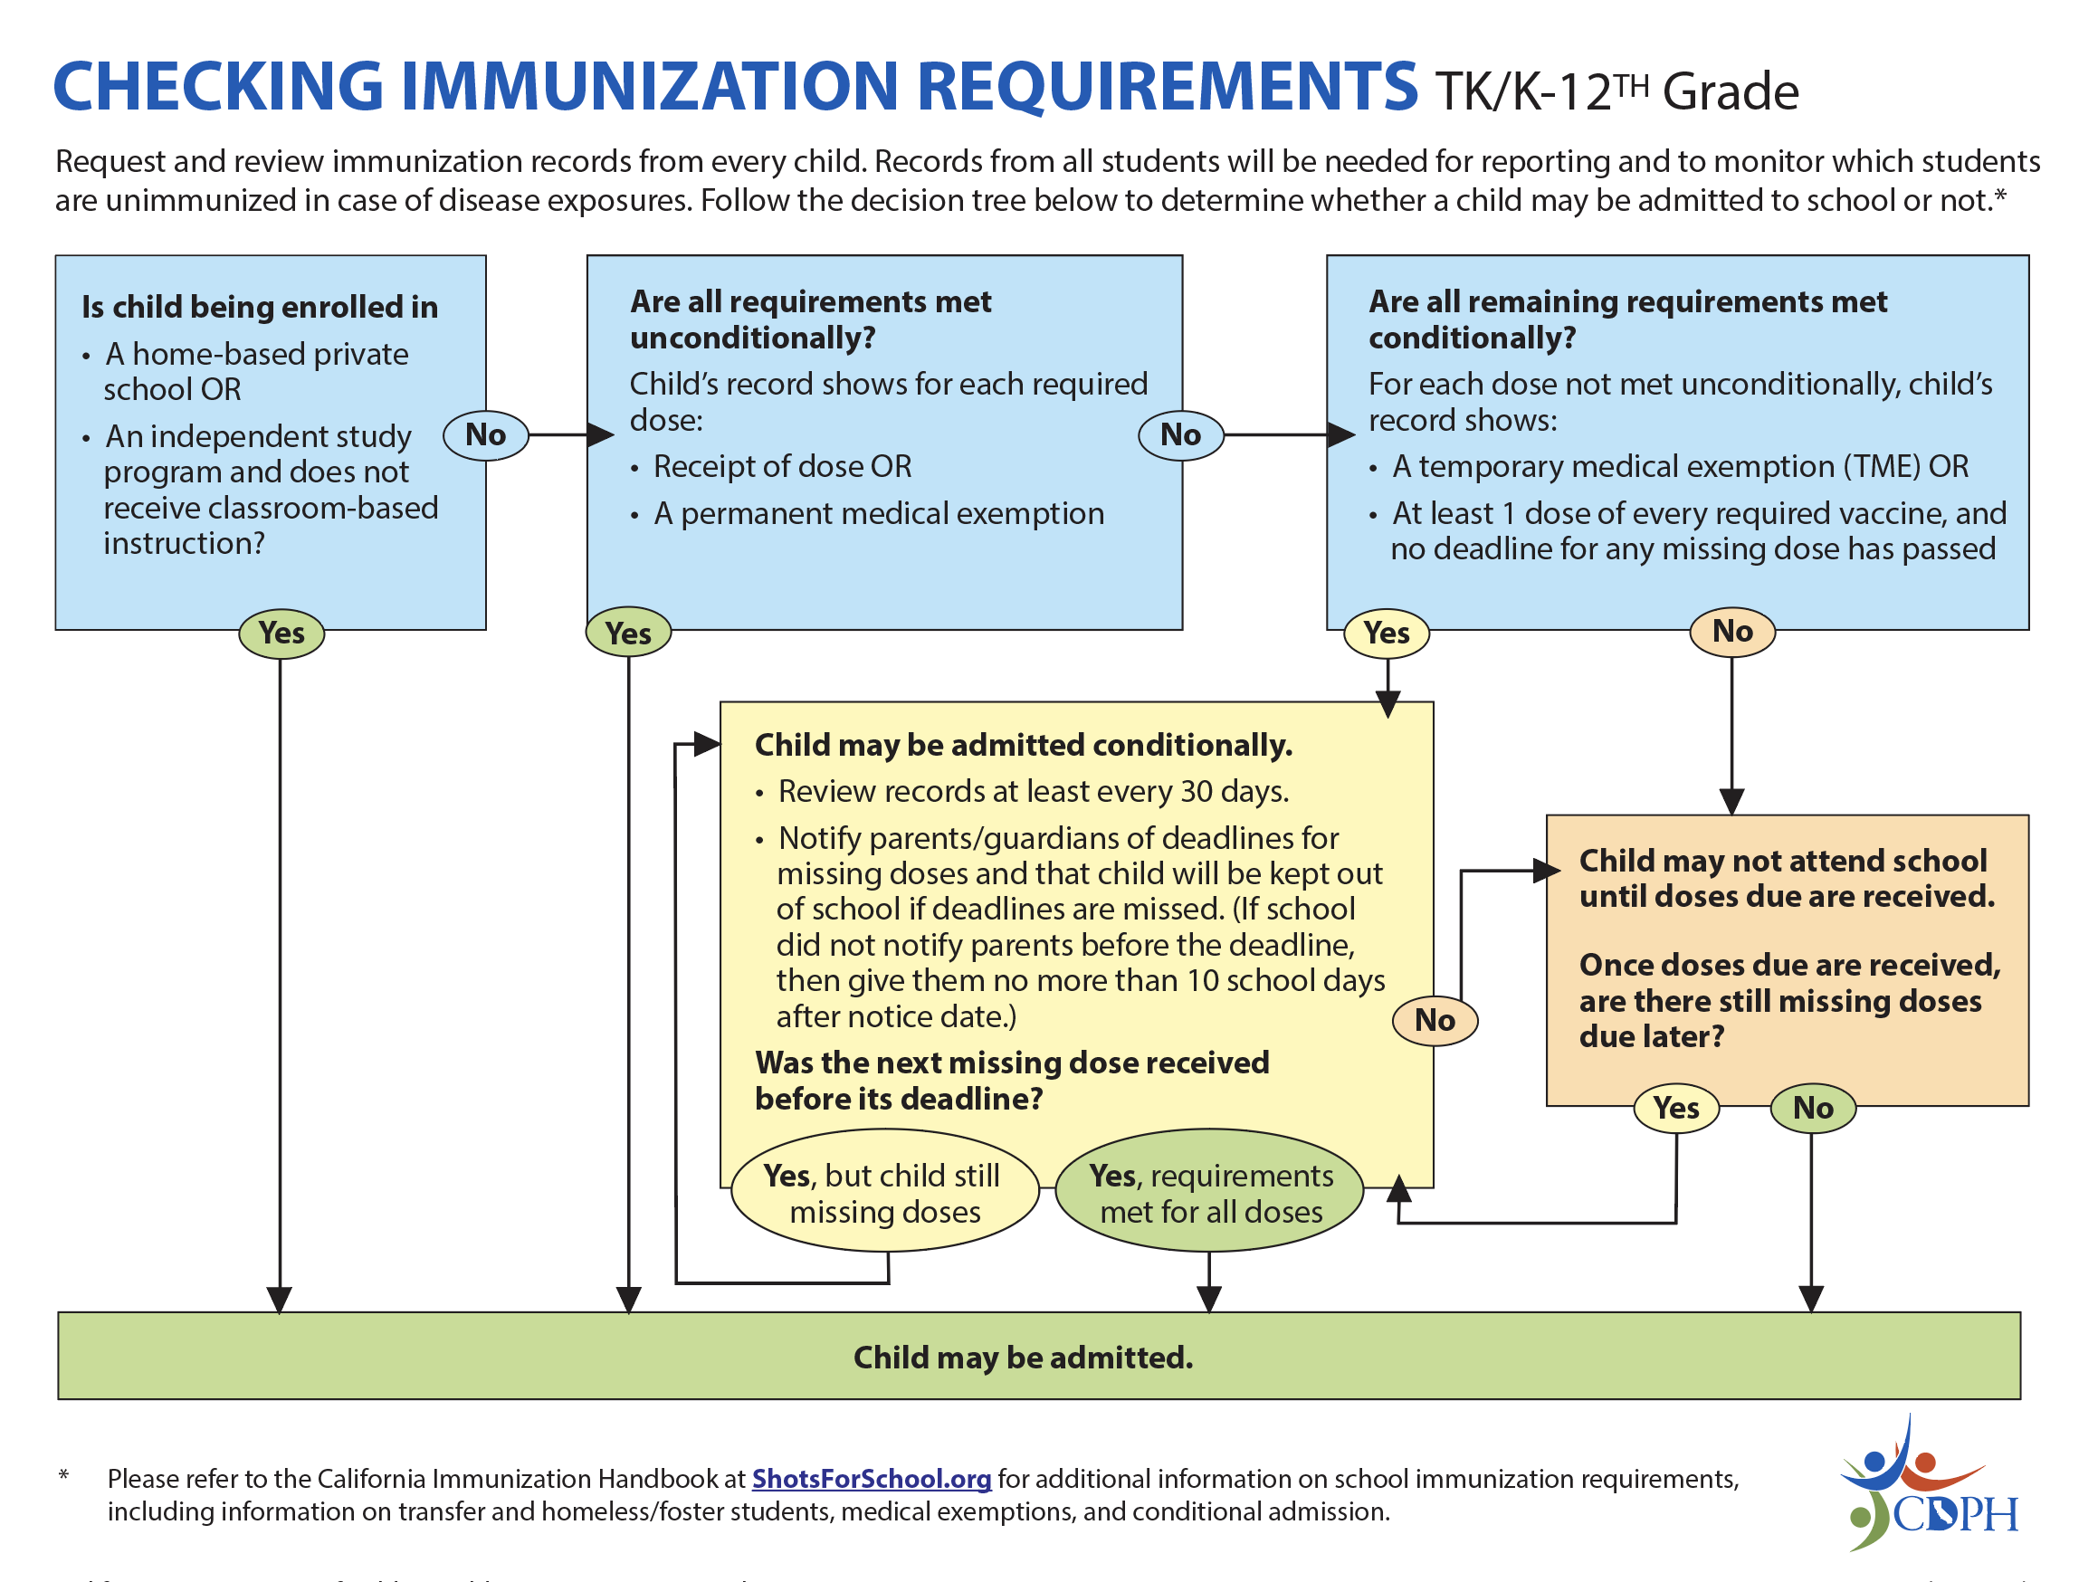
Resources
Instructors: See the notes section for more information.
Notes:
Resources include:
tips for communicating with parents about the immunization requirements and
this decision tree that helps guide you through the process of checking records that we went through today.
As well as a list of all vaccines with acronyms and brand names.

Slide 51
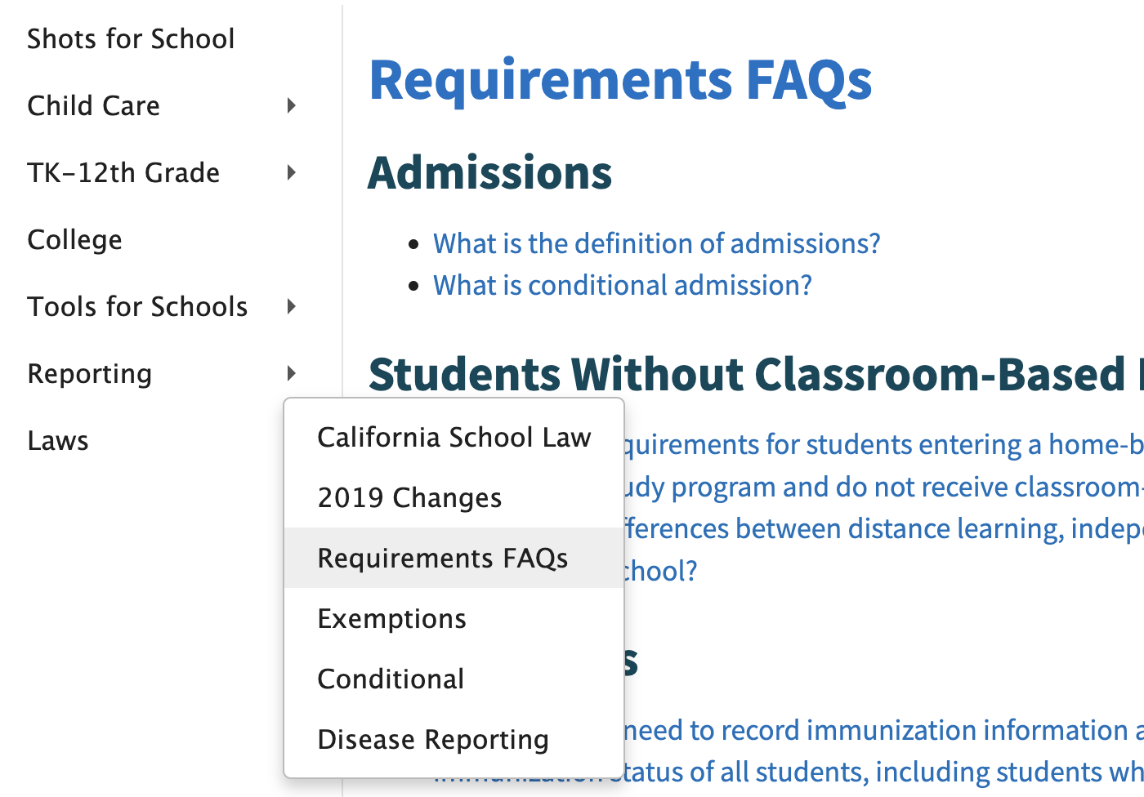
Answers
Send questions to [your email]
Instructors: See the notes section for more information.
Notes:
If you need more answers,
check out the California Immunization Handbook in the Tools for School section, or
FAQs in the Laws section of the Shots for School website or
Send me an email (instructor: fill in the email on the slide with your local contact) or
Email Shotsforschool@cdph.ca.gov

Slide 52
Other Helpful Websites
Check medical exemptions at: CAIR-ME.CDPH.CA.gov
Determine if a student meets all immunization requirements using the School & Child Care Roster Lookup (SCRL) : CAIRhub.CDPH.CA.gov

Slide 53
Thank You!

