Slide 1
California Pre-Kindergarten (Child Care) Immunization Requirements
Organization Name
Presenter Name
Date
Notes:
Welcome!
Instructors: feel free to replace the icons with your organization logo or other image.

Slide 2
Becoming Immunization Champions
Your organization name
Instructors: See the notes section for more information.
Notes:
Thank you all for becoming Immunization Champions and helping to keep our children safe from preventable diseases.
These slides will emphasize what is covered in the immunization trainings posted at the Shots for School website. These trainings should also be viewed by all staff tasked with checking and documenting immunizations required for childcare entry.

Slide 3
It’s the Law
Check immunization records and ensure children meet requirements before admission.
Your organization name
Instructors: See the notes section for more information.
Notes:
This poster can be posted where parents/guardians can see it. The file is available on the ShotsforSchool website. Printed copies may be available at some local health departments.

Slide 4
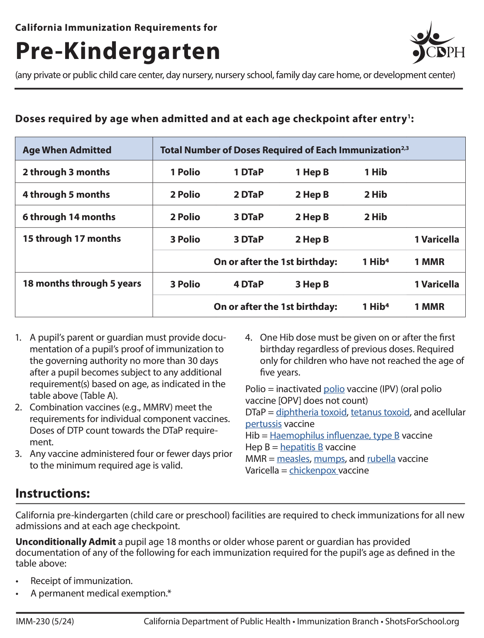
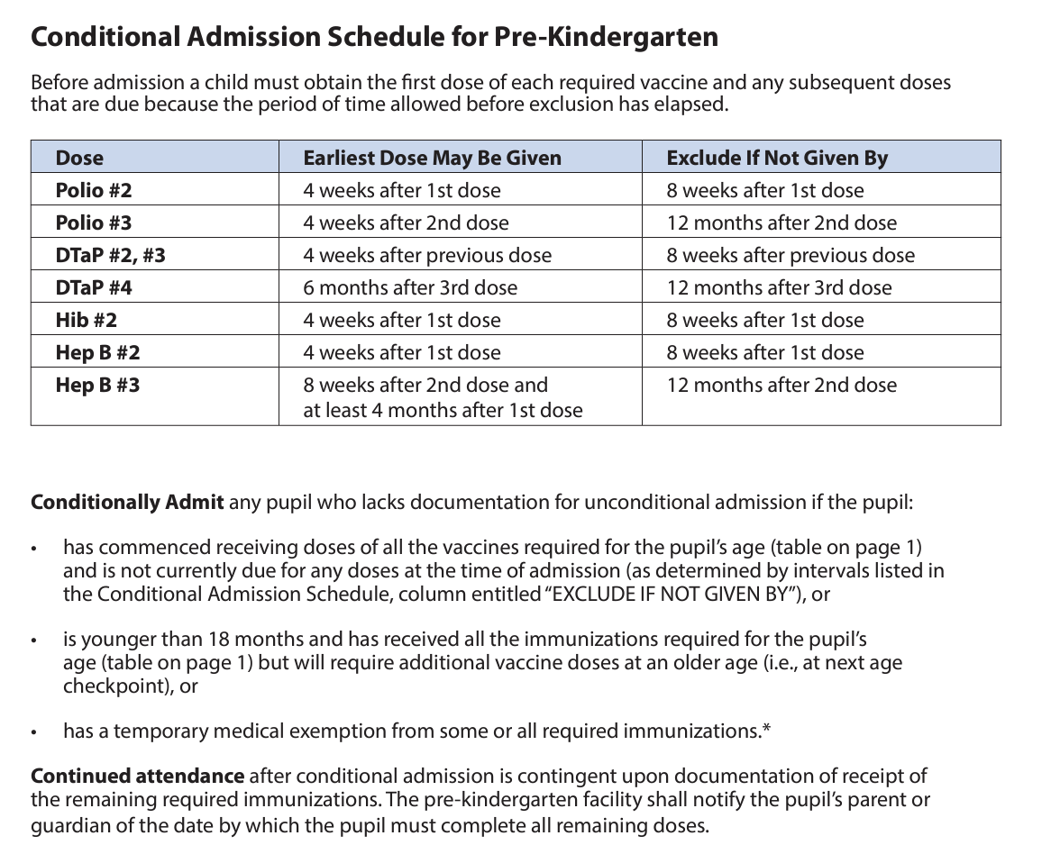
Pre-K (Child Care) Guide
Notes:
Quick reference.
The laws are summarized in the Child Care Guide. You all have copies.
We'll be using different parts of this guide throughout this training:
Table with requirements
Footnotes
Definitions
Conditional Admission table

Slide 5
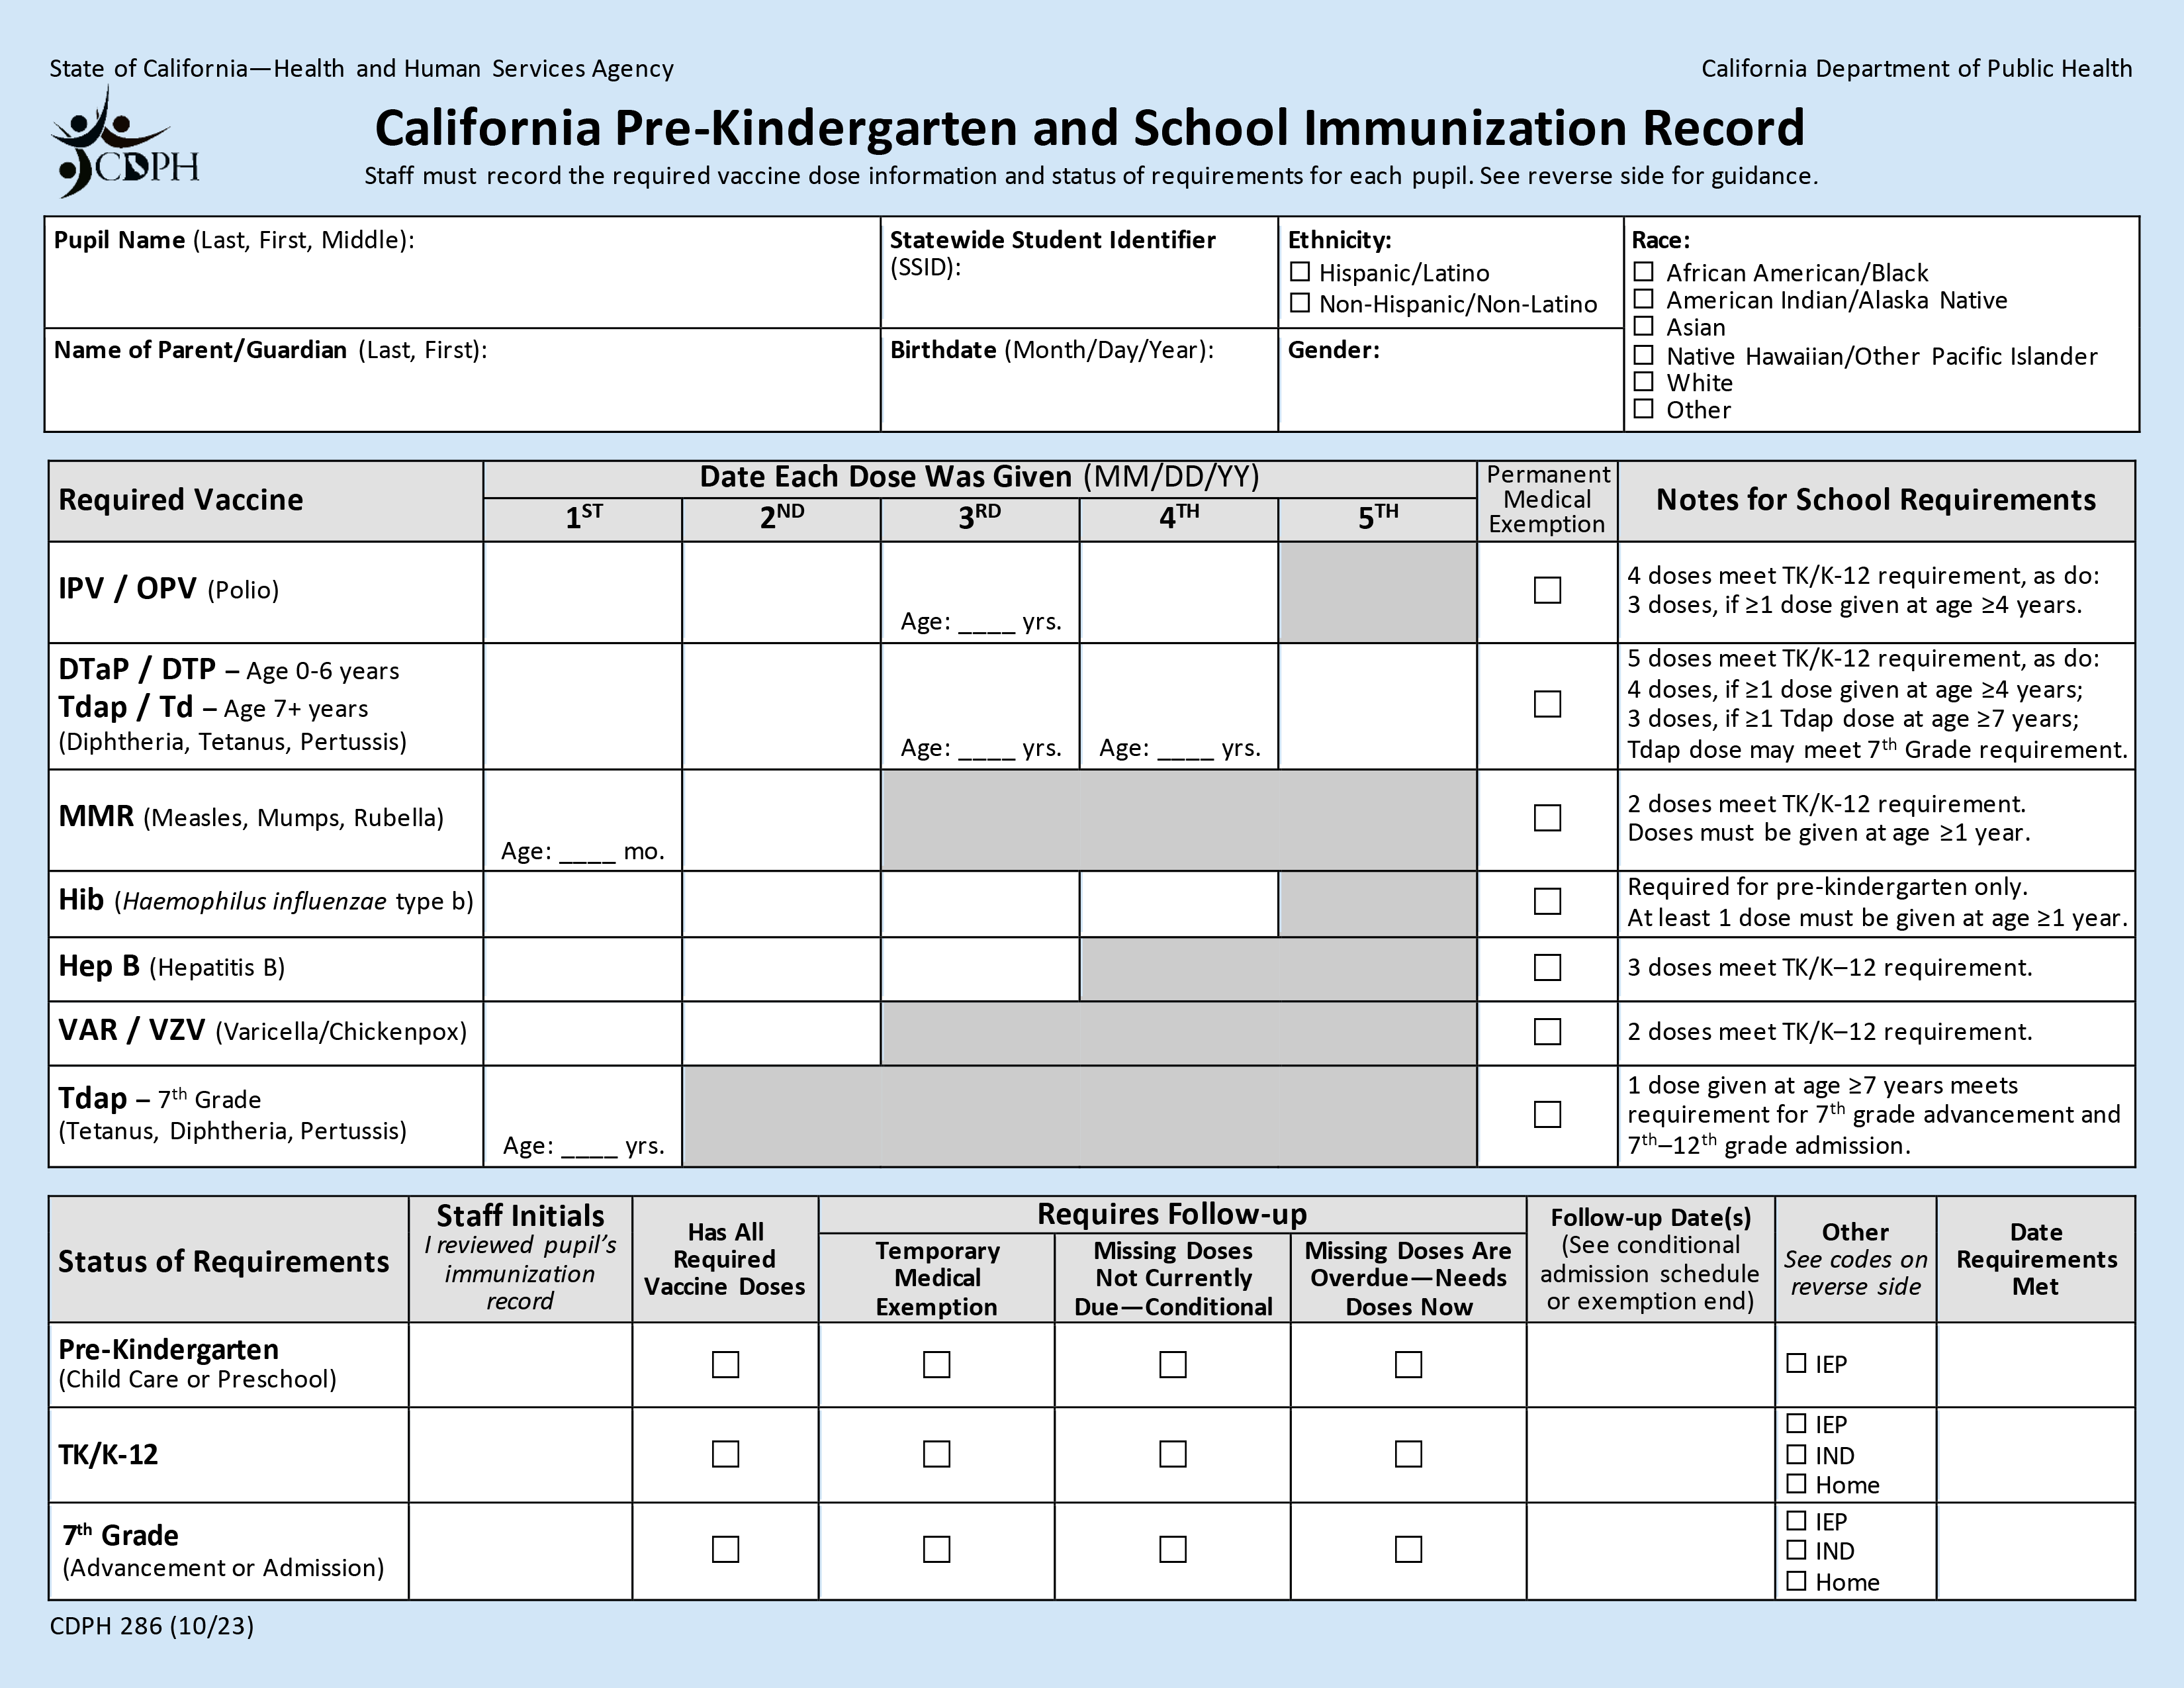
Blue Card
Notes:
Quick reference.
You all also have copies of the California Pre-K and School Immunization Record, also known as the Blue Card.
The Notes section on the Blue Card does not apply to Pre-K requirements. Please disregard them.
Some of your facilities may have Student Immunization Information Systems, but for the purpose of this training we're going to use the paper Blue Cards to create records.

Slide 6
Steps for Processing Records
Ask for child’s immunization record.
Transfer dates for doses to a Blue Card.
Determine if requirements are met.
Can the child be admitted?
Complete Status of Requirements section.
Notes:
These are the four basic steps to processing immunization records

Slide 7
Can A Student Attend Pre-K?
Unconditional Admission
Has all required doses (age 18+ months) OR
Permanent medical exemption (PME) for missing doses (age 18+ months) OR
Other: Individualized Education Program (IEP) Services
Conditional Admission
Missing doses are not due yet and has at least 1 dose of every required vaccine OR
Younger than 18 months old and has all required vaccines for their age OR
Temporary medical exemption (TME) for missing doses
X
Do Not Admit
7. Missing doses are overdue
Notes:
Note to instructor: "Conditional Admission" and "Do Not Admit" sections are timed to appear when you click the mouse.
It is your job to determine which category a child falls under and if they can attend pre-k or not. There are 7 categories under which students can fall:
Unconditional Admission means that children have met all requirements and can attend pre-k.
18 months or older and has all required doses OR
Permanent medical exemption (PME) for missing doses OR
Other: Children should receive services identified in their individualized education program (IEP) regardless of their immunization status. You'll still keep a Blue Card for these students with any immunization information they provide.
Conditional Admission means that children may attend pre-k on the condition they get the remaining doses when they are due.
These children will require follow-up.
Missing doses are not due yet (has at least 1 dose of every required vaccine) OR
Children younger than 18 months old who have all required doses for their age. See the earlier age checkpoints on the Guide. OR
Temporary medical exemption (TME) for missing doses
Children may not be admitted to pre-k if they are in this last category...
7. Missing doses are overdue

Slide 8
Let’s Practice
Pre-K Admission
August 15, 2024
Notes:
Let's practice going through the steps and determining which category each child falls under and if they may be admitted to pre-k.
For this overall training, we'll say that the start of pre-K will be on August 15, 2024.

Slide 9
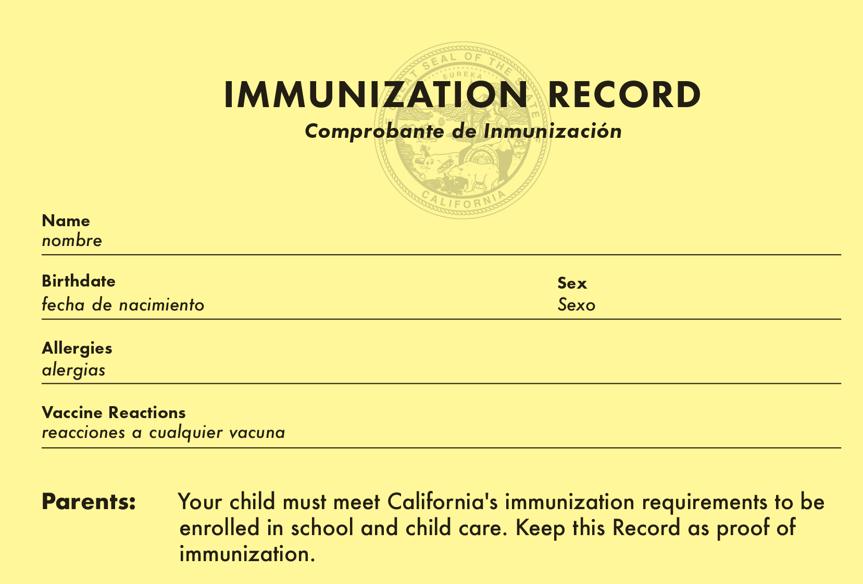
Student 1
2 Years Old
Student One
09/27/2021
Female
None
None
Required: Name, Birthdate, Vaccine, Date Given, Health Care Provider
Instructors: See the notes section for more information.
Notes:
Here's our first example: an immunization record (yellow card) for a child who is 2 years old.
Let’s start filling out a Blue Card with this information.
Note: when you receive a child’s immunization record, check for all these required elements:
Name,
Birthdate,
Vaccine,
Date Given,
Health Care Provider
Note: Vaccines and dates are on the next slide.
(To save time, Student 1 can be presented as a demonstration of steps rather than having the class fill out the Blue Card for this student.)

Slide 10
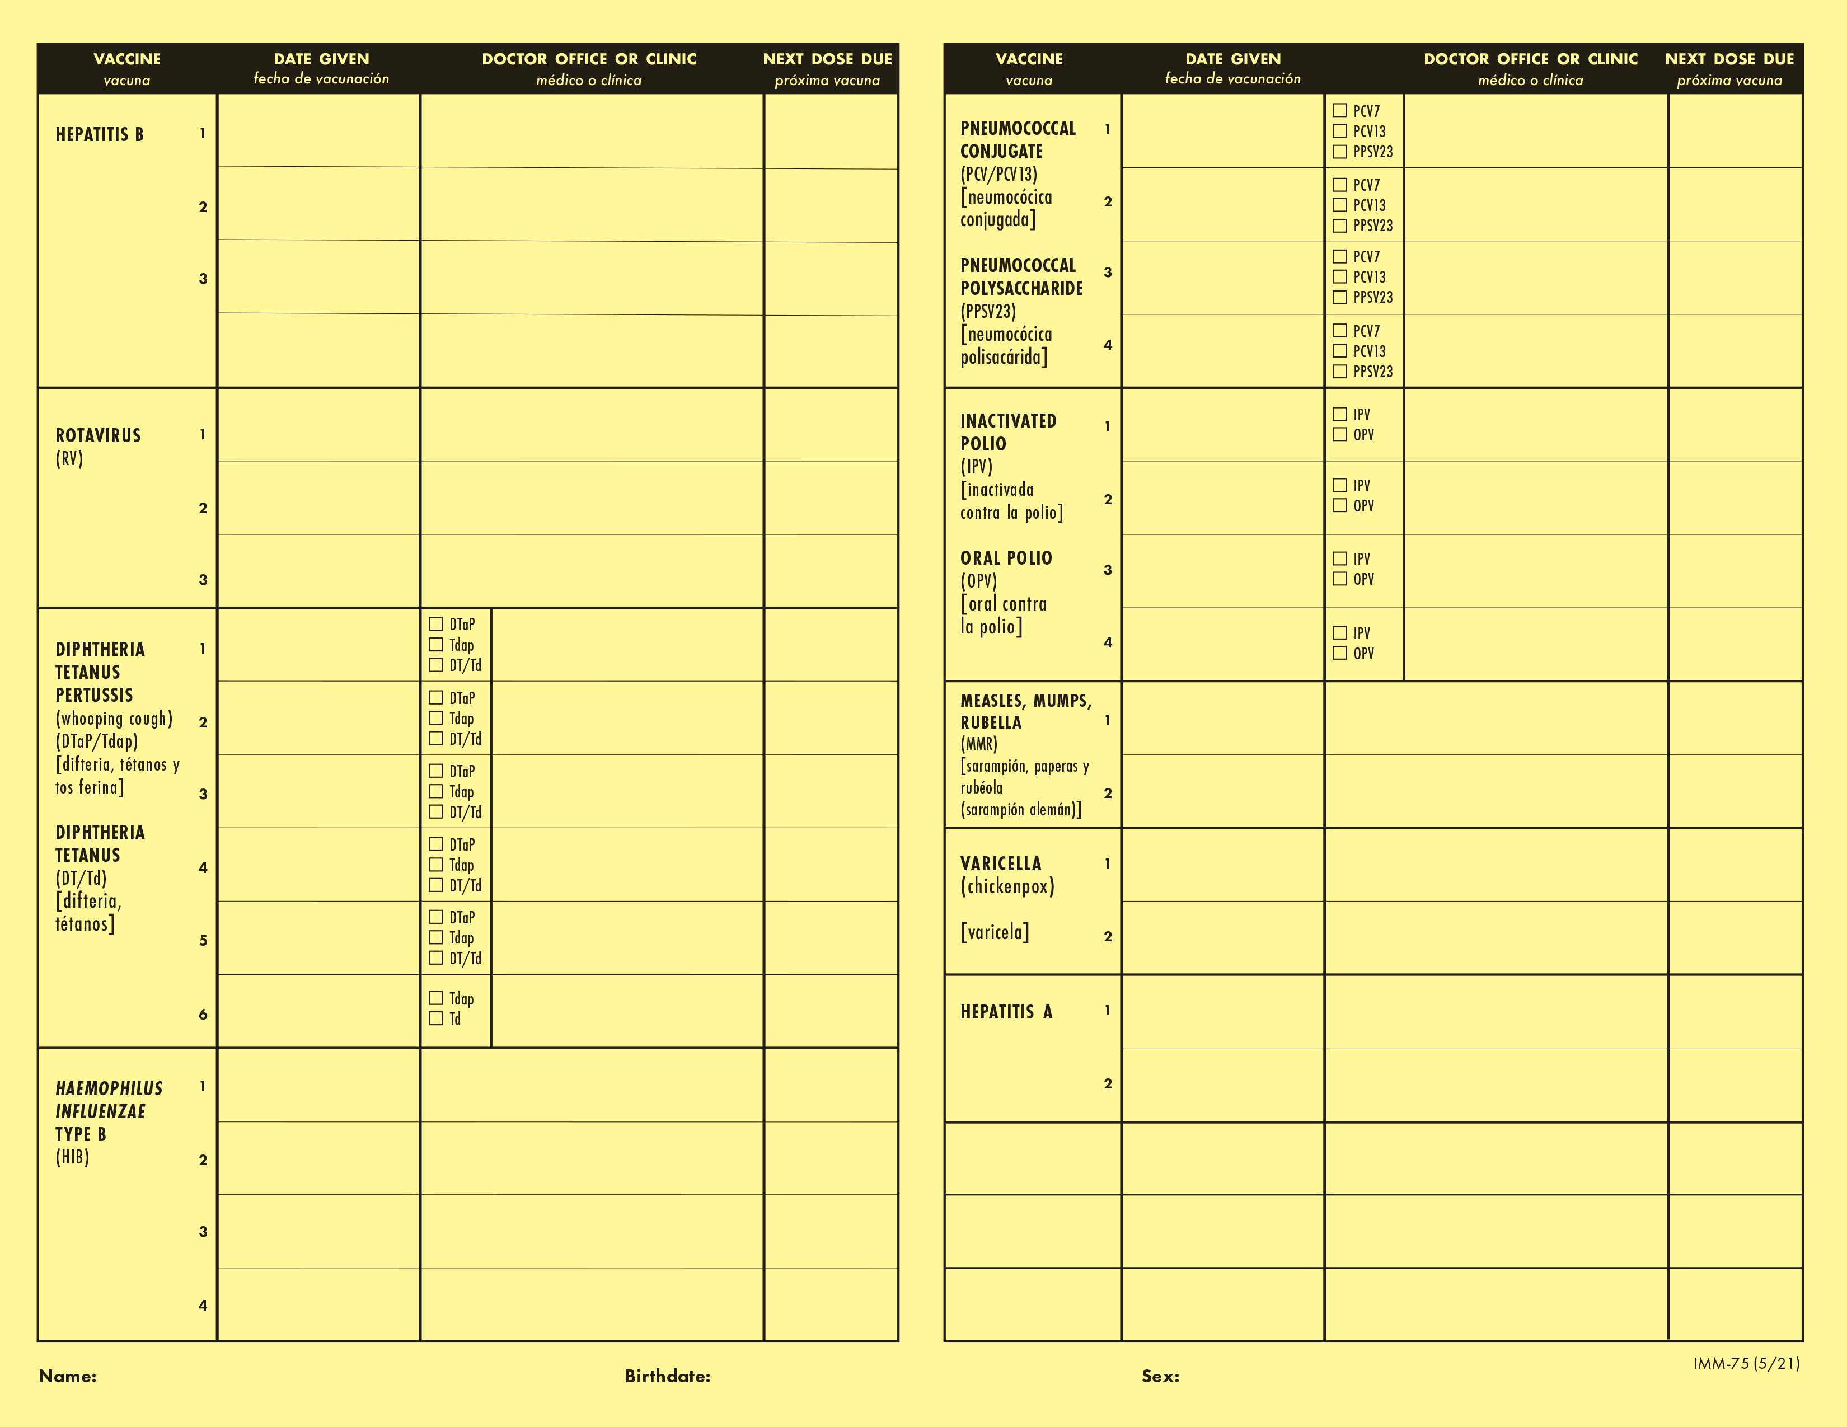
Student 1: Immunization Record
09/27/21
Happy Pediatrics
11/27/21
Happy Pediatrics
10/24/21
Happy Pediatrics
01/28/22
Happy Pediatrics
06/30/22
Happy Pediatrics
06/30/22
Happy Pediatrics
09/25/22
Happy Pediatrics
11/27/21
Happy Pediatrics
11/27/21
Happy Pediatrics
01/28/22
Happy Pediatrics
04/29/22
Happy Pediatrics
05/29/23
Happy Pediatrics
04/08/23
Happy Pediatrics
11/27/21
Happy Pediatrics
01/28/22
Happy Pediatrics
09/25/22
Happy Pediatrics
04/29/22
Happy Pediatrics
04/08/23
Happy Pediatrics
09/25/22
Happy Pediatrics
09/27/23
Happy Pediatrics
11/27/21
Happy Pediatrics
03/31/24
Happy Pediatrics
01/28/22
Happy Pediatrics
04/29/22
Happy Pediatrics
09/25/22
Happy Pediatrics
Instructors: See the notes section for more information.
Notes:
This side of the record shows the vaccines and dates.
Start transferring the dates for the doses to the Blue Card.

Slide 11
Student 1: Check Requirements
11/27/21
04/29/22
04/08/23
11/27/21
01/28/22
04/29/22
04/08/23
9/25/22
12
11/27/21
01/28/22
04/29/22
09/25/22
09/27/21
10/24/21
06/30/22
9/25/22
MMR #1: 2 days before the 1st birthday (4-day grace period)
Instructors: See the notes section for more information.
Notes:
This is what the filled out Blue Card should look like.
Refer to the Pre-K Guide to check if requirements are met.
Since this child is 2, we’ll use the last row for ages 18 months–5years.
IPV: 3 doses of polio, meets requirement
DTaP: 4 doses meet the requirement
MMR: Check the age requirement. First dose given just before the 1st birthday. There is a 4-day grace period, so this still meets the age requirement for MMR. Because the date is just 2 days before the 1st birthday, we’ll record the age as 12 months and not 11 months so it’s obvious that the requirement has been met.
Hib: last dose was 2 days before 1st birthday and within 4-day grace period, so meets the requirement
Hep B: 3 doses meets requirement
Varicella: 1 dose meets the requirement
Tdap: not required for pre-K
Birth date: 09/27/21

Slide 12
Has All Required Vaccine Doses: Unconditional
One, Student
123456789
X
One, Parent
09/27/2021
Female
X
11/27/21
04/29/22
04/08/23
11/27/21
01/28/22
04/29/22
04/08/23
9/25/22
12
11/27/21
01/28/22
04/29/22
10/11/22
09/27/21
10/24/21
06/30/22
9/25/22
AC
X
08/22/24
Instructors: See the notes section for more information.
Notes:
Fill out the Status of Requirements Section.
Student 1 may be unconditionally admitted. No follow-up required. They’re done until the next grade span at TK/K.

Slide 13
Student 2
Admission at 4 years old
Notes:
Student #2 is registering at 4 years of age, admission on August 15, 2024.

Slide 14
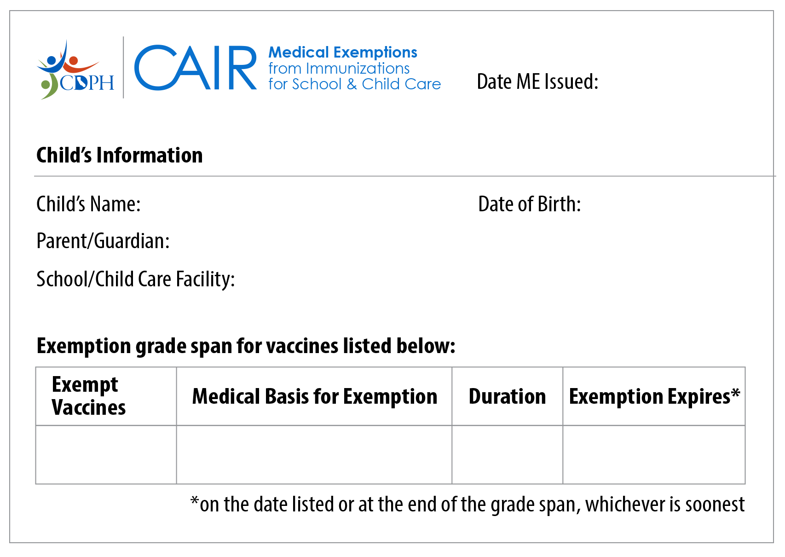
Student 2 (PME)
Permanent Medical Exemption
8/15/24
Student Two
04/21/2020
Parent Two
Happy Kids Preschool (1234567)
Child Care/Preschool
Varicella
Had chickenpox disease
Permanent
End of Child Care/Preschool
Instructors: See the notes section for more information.
Notes:
The parents have supplied a medical exemption.
Starting January 1, 2021, all new exemptions must be issued from the CAIR-ME website.
This is a representation of a Permanent Medical Exemption (PME) from CAIR-ME, not an exact copy.
Things to check for a valid PME:
Issue date
Child’s information
School’s information
Grade span
Exempt vaccines and expiration.
Use this name and birth date to fill out the Blue Card (since it will not be shown on immunization record on next slide).

Slide 15
Student 2: Immunization Record (page 1) Birth date: 04/21/2020
GROUP grupo | SERIES serie | DATE GIVEN fecha de vacunación | AGE GIVEN edad de vacunación | VACCINE Vacuna | CLINIC ADMINISTERED OR TRANSCRIBED administrada o transcrita en la clinica
COVID | 1 of 3 | 12/01/2021 | 1yrs 7mo 10d | Pfizer Pediatric COVID-19 | La Clinica de la Raza
COVID | 2 of 3 | 11/19/2022 | 2yrs 6mo 29d | Pfizer Pediatric COVID-19 | La Clinica de la Raza
COVID | 3 of 3 | 08/30/2023 | 3yrs 4mo 9d | Pfizer Pediatric COVID-19 | La Clinica de la Raza
DTaP | 1 of 5 | 06/16/2020 | 0yrs 1mo 26d | Pentacel | La Clinica de la Raza
DTaP | 2 of 5 | 08/22/2020 | 0yrs 4mo 1d | Pentacel | La Clinica de la Raza
DTaP | 3 of 5 | 11/23/2020 | 0yrs 7mo 2d | Pentacel | La Clinica de la Raza
DTaP | 4 of 5 | 11/02/2021 | 1yrs 6mo 12d | Deptacel | La Clinica de la Raza
DTaP | 5 of 5 | 05/15/2024 | 4yrs 24d | Kinrix | La Clinica de la Raza
Hep A | 1 of 2 | 04/21/2022 | 2yrs 0mo 0d | Vaqta | La Clinica de la Raza
Hep A | 2 of 2 | 10/26/2022 | 2yrs 6mo 5d | Vaqta | La Clinica de la Raza
Hep B | 1 of 3 | 04/21/2020 | 0yrs 0mo 0d | Engerix-B | La Clinica de la Raza
Hep B | 2 of 3 | 06/16/2020 | 0yrs 1mo 26d | Engerix-B | La Clinica de la Raza
Hep B | 3 of 3 | 01/24/2021 | 0yrs 9mo 3d | Engerix-B | La Clinica de la Raza
HIB | 1 of 4 | 06/16/2020 | 0yrs 1mo 26d | Pentacel | La Clinica de la Raza
HIB | 2 of 4 | 08/22/2020 | 0yrs 4mo 1d | Pentacel | La Clinica de la Raza
HIB | 3 of 4 | 11/23/2020 | 0yrs 7mo 2d | Pentacel | La Clinica de la Raza
Instructors: See the notes section for more information.
Notes:
This is page one of a cropped sample record from the California Immunization Registry.
Transfer the dates to the Blue Card.

Slide 16
Student 2: Immunization Record (page 2)
GROUP grupo | SERIES serie | DATE GIVEN fecha de vacunación | AGE GIVEN edad de vacunación | VACCINE Vacuna | CLINIC ADMINISTERED OR TRANSCRIBED administrada o transcrita en la clinica
HIB | 4 of 4 | 05/06/2021 | 1yrs 0mo 15d | Brand not specified | La Clinica de la Raza
MMR | 1 of 3 | 05/06/2021 | 1yrs 0mo 15d | MMR-II | La Clinica de la Raza
MMR | 2 of 2 | 05/15/2024 | 4yrs 0mo 24d | MMR-II | La Clinica de la Raza
PCV | 1 of 4 | 06/16/2020 | 0yrs 1mo 26d | Prevnar 13 | La Clinica de la Raza
PCV | 2 of 4 | 08/22/2020 | 0yrs 4mo 1d | Prevnar 13 | La Clinica de la Raza
PCV | 3 of 4 | 01/24/2021 | 0yrs 9mo 3d | Prevnar 13 | La Clinica de la Raza
PCV | 4 of 4 | 05/06/2021 | 1yrs 0mo 15d | Prevnar 13 | La Clinica de la Raza
Polio | 1 of 4 | 06/16/2020 | 0yrs 1mo 26d | Pentacel | La Clinica de la Raza
Polio | 2 of 4 | 08/22/2020 | 0yrs 4mo 1d | Pentacel | La Clinica de la Raza
Polio | 3 of 4 | 11/23/2020 | 0yrs 7mo 2d | Pentacel | La Clinica de la Raza
Polio | 4 of 4 | 05/15/2024 | 4yrs 0mo 24d | Kinrix | La Clinica de la Raza
RV | 1 of 3 | 06/16/2020 | 0yrs 1mo 26d | Rotarix | La Clinica de la Raza
RV | 2 of 3 | 08/22/2020 | 0yrs 4mo 1d | Rotarix | La Clinica de la Raza
Flu |  | 11/15/2022 | 2yrs 6mo 25d | Brand not specified | La Clinica de la Raza
Flu |  | 10/30/2023 | 3yrs 6mo 9d | Brand not specified | La Clinica de la Raza
Instructors: See the notes section for more information.
Notes:
Transfer the dates for the remaining immunizations from page 2 of the record.
Instructors: wait for the class to fill out blue cards before proceeding.

Slide 17
Student 2: Check Requirements
06/16/20
08/22/20
11/23/20
05/15/24
06/16/20
08/22/20
11/23/20
11/02/21
05/15/24
05/06/21 12
05/15/24
06/16/20
08/22/20
11/23/20
05/06/21
04/21/20
06/16/20
01/24/21
Missing varicella dose
Instructors: See the notes section for more information.
Notes:
After filling out all the dates, we see that this student is missing 1 varicella vaccine dose but has all the other required vaccines.
Remember the PME that was issued? This student is exempt from varicella.

Slide 18
PME + All Other Doses: Unconditional
Two, Student
123456789
X
X
Two, Parent
04/21/2020
Male
06/16/20
08/22/20
11/23/20
05/15/24
06/16/20
08/22/20
11/23/20
11/02/21
05/15/24
05/06/21 12
05/15/24
06/16/20
08/22/20
11/23/20
05/06/21
04/21/20
06/16/20
01/24/21
X
AC
08/22/24
Instructors: See the notes section for more information.
Notes:
The PME meets the requirements for the missing varicella doses and the student has all other required doses. This student may be admitted unconditionally.
Add an “x” in the PME column for varicella
In the Status of Requirements section, add your initials, do not mark “Has All Required Vaccine Doses” because the student is missing varicella. Add the date.
Student 2 may be admitted unconditionally. Unconditional admission means no follow-up is required. They’re done until the next grade span at TK/kindergarten, or prior to that if their exemption is revoked.

Slide 19
Student 3
Admission at 3 Years Old

Slide 20
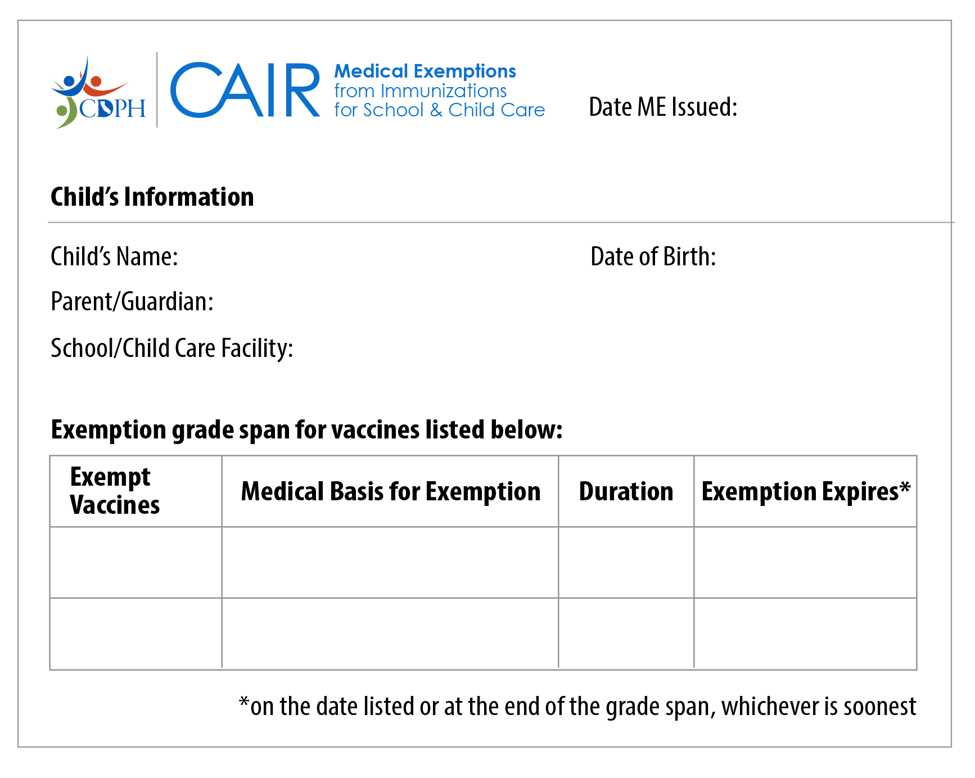
Student 3 (TME)
Temporary Medical Exemption
08/15/24
Student Three
11/29/2020
Parent Three
Champions Elementary
Child Care/Preschool
MMR
immunosuppression
Temporary
12/15/24
Varicella
immunosuppression
Temporary
12/15/24
Instructors: See the notes section for more information.
Notes:
This student is registering for preschool and has a medical exemption issued from CAIR ME. We can see that it is a temporary medical exemption or TME.
The student is exempt from varicella and MMR vaccines until the expiration date.
Please make a note of this expiration date as you’ll need it for following up for continued attendance.

Slide 21
Student 3 (Immunization Record page 1)
Name: Student Three | DOB: 11/29/2020 | MRN:1234567 | PCP: Becca Monte, MD
Current Immunizations
COVID-19 Vaccine
Dates on file: 11/05/2022, 06/10/2022
Diphtheria, Tetanus, Pertussis (DTaP) Vaccine
Dates on file: 06/10/2022, 07/01/2021, 03/30/2021, 01/24/2021
Flu Vaccine
Dates on file: 10/27/2023, 10/17/2022, 10/28/2021
Haemophilus influenza type B (HIB) Vaccine
Dates on file: 12/13/2021, 07/01/2021, 03/30/2021, 01/24/2021
Hepatitis A Vaccine
Dates on file: 06/02/2023, 11/29/2022
Hepatitis B Vaccine
Dates on file: 09/01/2021, 12/26/2020, 11/29/2020
Instructors: See the notes section for more information.
Notes:
Sample record from Electronic Health Record (EHR).
Transfer the dates for doses to the Blue Card.
Note that the dates go in order of most recent first.

Slide 22
Student 3 (Immunization Record page 2)
Pneumonia vaccine (pneumococcal) Vaccine
Dates on file: 12/13/2021, 09/01/2021, 03/30/2021, 01/24/2021
Polio (IPV) Vaccine
Dates on file: 06/10/2022, 07/01/2021, 03/30/2021
Rotavirus Vaccine
Dates on file: 05/30/2021, 03/30/2021, 01/30/2021
Instructors: See the notes section for more information.
Notes:
Now, transfer the dates for required doses on page 2.

Slide 23
Student 3: Check Requirements
03/30/21
07/01/21
06/10/22
01/24/21
03/30/21
07/01/21
06/10/22
01/24/21
03/30/21
07/01/21
12/13/21
11/29/20
12/26/20
09/01/21
Missing MMR #1 and varicella #1
Instructors: See the notes section for more information.
Notes:
After filling out all of the dates, we see that the student is missing:
The 1st doses of MMR and of varicella
They have all the other required vaccines for their age.

Slide 24
TME + All Other Doses: Conditional
Three, Student
123456789
X
X
Three, Parent
11/29/2020
Female
Deadline
MMR & Varicella #1
12/15/24
Follow-Up
11/15/24
03/30/21
07/01/21
06/10/22
01/24/21
03/30/21
07/01/21
06/10/22 1
01/24/21
03/30/21
07/01/21
12/13/21
11/29/20
12/26/20
09/01/21
NN
X
11/15/24
Instructors: See the notes section for more information.
Notes:
Remember that this child has a TME for the missing MMR and varicella doses and they have all other required doses.
We'll process this student differently than the Permanent Medical Exemption scenario.
Student 3 may be admitted Conditionally.
Follow-up is required before the TME expires.
Make a note of the exemption expiration date in December.
It’s best to send a reminder at least a month before the deadline. We'll show you how to do this with the next student.
In the Status of Requirements section:
Add your initials, and mark “Temporary Medical Exemption”.
Add the follow-up date.
Parents will need to show proof of receiving the missing doses or a new TME before the expiration date in order for the student to continue to attend preschool.

Slide 25
Student 4
At Ages 3, 4, 6 Months
Notes:
We’ll follow this next child from admission through several age checkpoints.

Slide 26
Student 4 (Immunization Record – 3 months)
Name: Student Four | DOB: 05/02/2024 | MRN:1234567 | PCP: Becca Monte, MD
Current Immunizations
Diphtheria, Tetanus, Pertussis (DTaP) Vaccine
Dates on file: 07/10/2024
Haemophilus influenza type B (HIB) Vaccine
Dates on file: 07/10/2024
Hepatitis B Vaccine
Dates on file: 07/10/2024, 05/02/2024
Pneumonia vaccine (pneumococcal) Vaccine
Dates on file: 07/10/2024
Polio (IPV) Vaccine
Dates on file: 07/10/2024
Rotavirus (RV) Vaccine
Dates on file: 07/10/2024
Instructors: See the notes section for more information.
Notes:
Sample record for Student 4 at 3 months of age.
Transfer the dates for doses to the Blue Card.

Slide 27
Student 4: Age 3 months
07/10/24
07/10/24
07/10/24
05/02/24
07/10/24
Instructors: See the notes section for more information.
Notes:
Let’s check the Pre-K Guide to see if this 3-month old can be admitted to child care.
1 polio
1 DTaP
1 Hib
She has two doses of Hep B, only one is required at this age.
Student 4 meets the requirements for admission at age 3 months.

Slide 28
Student 4: Age 3 months - What’s next?
07/10/24
07/10/24
07/10/24
05/02/24
07/10/24
Instructors: See the notes section for more information.
Notes:
Because Student 4 has more immunizations required as she gets older, this child is admitted Conditionally. This means that you’ll need to check again at each age check point (ages 4, 6, 15, and 18 months) to see if requirements are met.
Let’s check the Pre-K Guide to see the next checkpoints and what’s required at 4 months of age
2nd polio
2nd DTaP
2nd Hib
She already has two doses of Hep B, so has met the 2-dose Hep B requirement for that checkpoint

Slide 29
Student 4: Conditional at 3 months
Four, Student
123456789
X
X
Four, Parent
05/02/2024
Female
Deadline
Polio, DTaP, Hib #2
9/2/24
Follow-Up
Now
07/10/24
07/10/24
07/10/24
05/02/24
07/10/24
JG
X
8/15/24
Instructors: See the notes section for more information.
Notes:
Let’s fill out a sticky note with all the doses which are due at 4 months of age.
In the Status of Requirements section:
Add your initials, and mark “Missing Doses Not Currently Due”.
Add the follow-up date. This is usually a month before the next age checkpoint. In this scenario that is just a few weeks away, so let’s follow-up now.

Slide 30
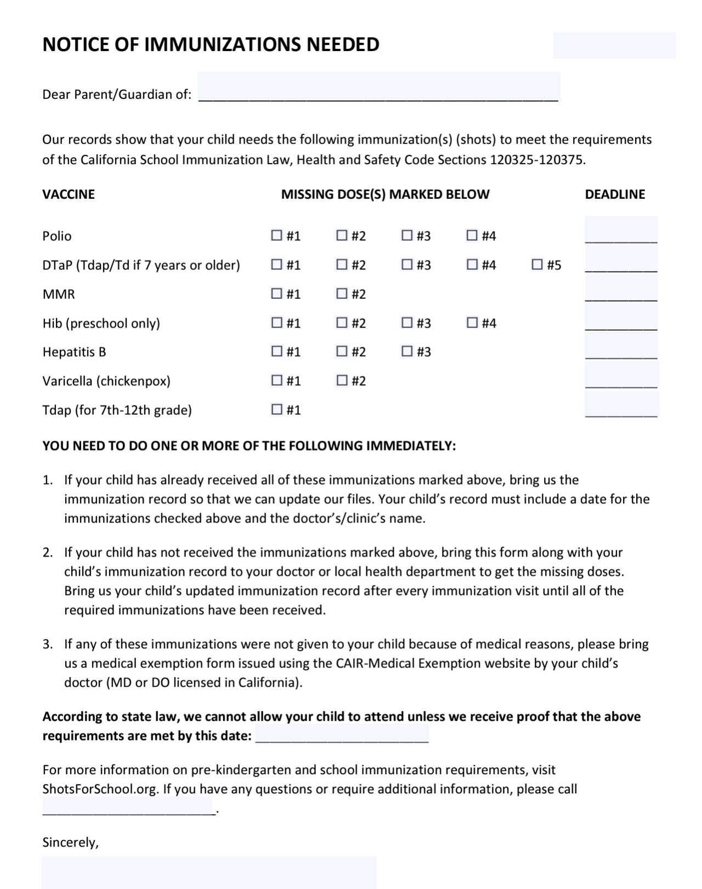
Send a Reminder for Next Checkpoint
8/15/24
Student Four
Deadline
Polio, DTaP, Hib #2
9/2/24
Follow-Up
Now
X
09/02/24
X
09/02/24
X
09/02/24
09/02/24
1-888-867-5309
Your Name
Instructors: See the notes section for more information.
Notes:
Fill out a Notice of Immunizations Needed letter and send it to parents. This template can be downloaded in multiple languages from the Shots for School website.
Copy the deadline dates over that we already calculated on the sticky note.
All missing vaccines are due when she turns 4 months old on 9/2/24. If records are not submitted by then, parents have 30 more days to submit records. The deadline can be updated on the letter if needed.

Slide 31
Student 4 (Immunization Record – 4 months)
Name: Student Four | DOB: 05/02/2024 | MRN:1234567 | PCP: Becca Monte, MD
Current Immunizations
Diphtheria, Tetanus, Pertussis (DTaP) Vaccine
Dates on file: 09/06/2024, 07/10/2024
Haemophilus influenza type B (HIB) Vaccine
Dates on file: 09/06/2024, 07/10/2024
Hepatitis B Vaccine
Dates on file: 07/10/2024, 05/02/2024
Pneumonia vaccine (pneumococcal) Vaccine
Dates on file: 09/06/2024, 07/10/2024
Polio (IPV) Vaccine
Dates on file: 09/06/2024, 07/10/2024
Rotavirus (RV) Vaccine
Dates on file: 09/06/2024, 07/10/2024
Instructors: See the notes section for more information.
Notes:
Student 4’s parents give you an updated record at 4 months of age.
Copy the new dates to the Blue Card

Slide 32
Student 4: Age 4 months
07/10/24
09/06/24
07/10/24
09/06/24
07/10/24
09/06/24
05/02/24
07/10/24
Instructors: See the notes section for more information.
Notes:
Check The Guide to see if she meets the requirements for the 4-month age checkpoint:
2 polio
2 DTaP
2 Hib
2 Hep B
Yes she does meet these requirements.

Slide 33
Student 4: Age 4 months - What’s next?
07/10/24
09/06/24
07/10/24
09/06/24
07/10/24
09/06/24
05/02/24
07/10/24
Instructors: See the notes section for more information.
Notes:
Now, check the Pre-K Guide to see what’s due at the next check-point (6 months of age).
2 polio- done
2 Hib-done
2 Hep B-done
Only the 3rd dose of DTaP is needed.
Calculate the deadline and follow-up date and write it on a sticky note.

Slide 34
Student 4: Conditional at 4 months
Four, Student
123456789
X
X
Four, Parent
05/02/2024
Female
Deadline
DTaP #3
11/2/24
Follow-Up
10/2/24
07/10/24
09/06/24
07/10/24
09/06/24
07/10/24
09/06/24
05/02/24
07/10/24
JG
X
9/02/24 10/02/24
Instructors: See the notes section for more information.
Notes:
This student may continue to attend child care conditionally until the next age checkpoint.
Update the Status of Requirements section:
Cross out the old follow-up date and add the new date, a month before she turns 6 months of age.
Send the reminder to parents in October and repeat the process for the 6-month age checkpoint.
Note to presenter: It may help for trainees to share tips about logging multiple follow up dates; e.g., erasable pen, post-its with follow up dates, use electronic Blue Card, white out, etc.

Slide 35
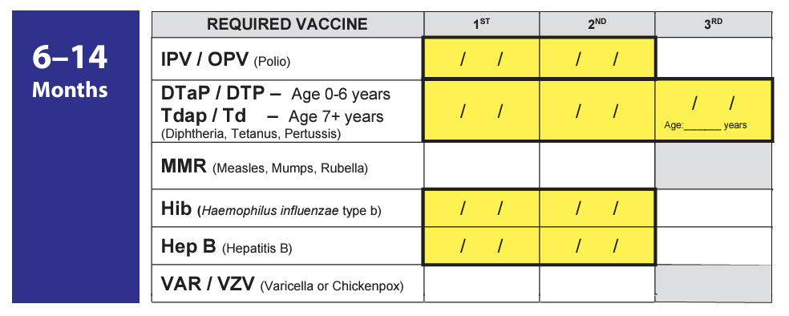
Student 4: Age 6 months
07/10/24
09/06/24
07/10/24
09/06/24
11/01/24
07/10/24
09/06/24
05/02/24
07/10/24
Instructors: See the notes section for more information.
Notes:
Student 4’s parents submitted another new record with the third dose of DTaP added.
Now that you’ve got the hang of this. Let’s try this other tool to see if she meets the requirements for 6 months of age.
All you have to do is compare the highlighted spaces on the bottom to see if the same places on the Blue Card is filled out.
Polio 1 & 2: check
DTaP 1, 2, 3: check
Hib1 & 2: check
Hep B 1 & 2: check
She can continue to attend child care, conditionally. (Click mouse to add yellow check mark to the screen)
Note to presenter: Print out copies of this tool “Pre-Kindergarten Requirements Highlighted on Blue Card” and have trainees put it next to their Blue Cards

Slide 36
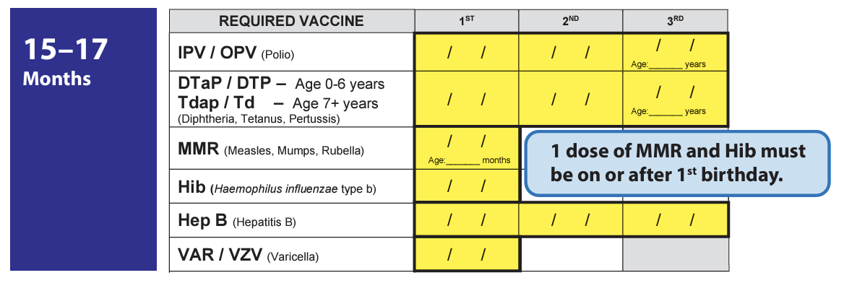
Student 4: Age 6 months - What’s next?
07/10/24
09/06/24
07/10/24
09/06/24
11/01/24
07/10/24
09/06/24
05/02/24
07/10/24
Instructors: See the notes section for more information.
Notes:
What’s next for Student 4? Her next checkpoint isn’t until 15 months of age.
Use the yellow highlights to figure out which doses will be due next.
Polio #3
MMR: 1 dose on or after 1st birthday
Hib: 1 dose on or after 1st birthday (her two doses are both before age 1 so she’ll need another dose to meet this requirement.)
Hep B #3
Varicella #1
Send a reminder notice and check for required immunizations before the child turns 15 months. Take a look at the 18-month check point for the final list of required doses before we move on to the next student scenario.

Slide 37
Student 5
Age 2 years

Slide 38
Student 5: Immunization Record DOB: 02/11/2022
GROUP grupo | SERIES serie | DATE GIVEN fecha de vacunación | AGE GIVEN edad de vacunación | VACCINE Vacuna | CLINIC ADMINISTERED OR TRANSCRIBED administrada o transcrita en la clinica
COVID | 1 | 12/01/2024 | 2yrs 9mo 20d | Pfizer Pediatric COVID-19 | La Clinica de la Raza
DTaP | 1 of 5 | 04/19/2022 | 0yrs 2mo 8d | Pentacel | La Clinica de la Raza
DTaP | 2 of 5 | 07/24/2024 | 2yrs 5mo 13d | Pentacel | La Clinica de la Raza
Hep A | 1 of 2 | 04/21/2023 | 1yrs 2mo 10d | Vaqta | Transcribed
Hep A | 2 of 2 | 10/26/2023 | 1yrs 8mo 15d | Vaqta | Transcribed
Hep B | 1 of 3 | 02/12/2022 | 0yrs 0mo 1d | Engerix-B | La Clinica de la Raza
Hep B | 2 of 3 | 03/15/2022 | 0yrs 1mo 3d | Engerix-B | La Clinica de la Raza
Hep B | 3 of 3 | 10/25/2023 | 1yrs 8mo 14d | Engerix-B | Transcribed
HIB | 1 of 4 | 04/19/2022 | 0yrs 2mo 8d | Pentacel | La Clinica de la Raza
HIB | 2 of 4 | 07/24/2024 | 2yrs 5mo 13d | Pentacel | La Clinica de la Raza
Instructors: See the notes section for more information.
Notes:
Transfer the dates to the Blue Card for Student 5

Slide 39
Student 5: Immunization Record (page 2)
GROUP grupo | SERIES serie | DATE GIVEN fecha de vacunación | AGE GIVEN edad de vacunación | VACCINE Vacuna | CLINIC ADMINISTERED OR TRANSCRIBED administrada o transcrita en la clinica
MMR | 1 of 2 | 02/20/2023 | 1yrs 0mo 9d | Proquad | Transcribed
PCV | 1 of 4 | 04/19/2022 | 0yrs 2mo 8d | Prevnar 13 | La Clinica de la Raza
PCV | 2 of 4 | 06/24/2022 | 0yrs 4mo 13d | Prevnar 13 | La Clinica de la Raza
PCV | 3 of 4 | 08/29/2022 | 0yrs 6mo 18d | Prevnar 13 | Transcribed
PCV | 4 of 4 | 05/15/2023 | 1yrs 3mo 4d | Prevnar 13 | Transcribed
Polio | 1 of 4 | 04/19/2022 | 0yrs 2mo 8d | Pentacel | La Clinica de la Raza
Polio | 2 of 4 | 07/24/2024 | 2yrs 5mo 13d | Pentacel | La Clinica de la Raza
RV | 1 of 3 | 04/19/2022 | 0yrs 2mo 8d | Rotarix | La Clinica de la Raza
RV | 2 of 3 | 06/24/2022 | 0yrs 4mo 13d | Rotarix | La Clinica de la Raza
Var | 1 of 2 | 02/20/2023 | 1yrs 0mo 9d | Proquad | Transcribed
Flu |  | 11/15/2022 | 0yrs 9mo 4d | Brand not specified | Transcribed
Flu |  | 10/30/2023 | 1yrs 8mo 19d | Brand not specified | Transcribed
Instructors: See the notes section for more information.
Notes:
Transfer the dates for the remaining immunizations from page 2 of the record.
Now, check your Blue Card to see if Student 5 meets the requirements for their age, 2 years.
You may use either the Guide or the Highlighted Blue Card tool.

Slide 40
Student 5: Blue Card (August)
04/19/22
07/24/24
04/19/22
07/24/24
02/20/23
12
04/19/22
07/24/24
02/12/22
03/15/22
10/25/23
02/20/23
Missing polio and DTaP vaccines
Instructors: See the notes section for more information.
Notes:
Polio: 3 doses required; missing one dose
DTaP: 4 doses required; missing two doses.
MMR: Has 1 dose. Is this dose on or after the 1st birthday? Check.
Hib: Has 2 doses. Was one given on or after the 1st birthday? Yes, the 2nd dose was.
Hep B: 3 doses, check
Varicella: 1 dose, check.

Slide 41
Student 5: Check Due Date
Polio #2: 07/24/24
Polio #3:
Deadline: 07/24/25 DTaP #3:
Deadline: 09/18/24
12 months
DTaP #2: 07/24/24
8 weeks
Instructors: See the notes section for more information.
Notes:
The child is in the last age group, so for any missing doses we’ll check the conditional admission schedule for when the deadlines are for these missing doses. Turn to the Conditional Admission Schedule on page 2 of the Guide.
Polio #3 is not due until 12 months after the 2nd dose.
DTaP #3 is due much sooner, but not until 8 weeks after the 1st dose.
Checking the Blue Card
Polio #2 was given on July 24, 2024. Polio #3 is due 12 months later which is July 24, 2025. So, the deadline for Polio #3 is not until next year.
DTaP #2 was given on July 24, 2024. DTaP #3 is due 8 weeks later which is September 18, 2024.
Both doses are not due before the child will be attending preschool on August 15, 2024.
Can this child be admitted to preschool?
Yes, since the missing doses are not due before preschool starts, Student 5 may be admitted conditionally. They may attend preschool on the “condition” that the receive the missing doses by the deadline.
Now let’s try to figure out when the best follow-up date is.

Slide 42
Student 5: Set Follow-Up Date
Polio #2: 07/24/24
Polio #3:
Deadline: 07/24/25 Reminder: 08/21/24
DTaP #3:
Deadline: 09/18/24 Reminder: 08/21/24
4 weeks
DTaP #2: 07/24/24
4 weeks
Instructors: See the notes section for more information.
Notes:
When should we follow up with parents about the missing doses? Check the earliest dose may be given column. The third doses for both vaccines can be given as early as 4 weeks after the 2nd doses.
Send a reminder to parents about the deadlines for both vaccines. If there are different reminder dates, use the earlier date to send the reminder.

Slide 43
Missing Doses Not Due: Conditional
Five, Student
123456789
X
X
Five, Parent
02/11/2022
Female
04/19/22
07/24/24
04/19/22
07/24/24
02/20/23
12
04/19/22
07/24/24
02/12/22
03/15/22
10/25/23
02/20/23
KF
X
08/21/24
Instructors: See the notes section for more information.
Notes:
Since we determined the missing doses are not due yet, Student 5 may be admitted conditionally. Mark the Missing Doses Not Currently Due column and add the follow-up date for when you will send a reminder.

Slide 44
Send a Reminder
8/21/24
Student Five
X
07/24/25
X
09/18/24
Polio #3:
Deadline: 07/24/25 Reminder: 08/21/24
DTaP #3:
Deadline: 09/18/24 Reminder: 08/21/24
09/18/24
1-888-867-5309
Your Name
Instructors: See the notes section for more information.
Notes:
When it's time to follow-up, fill out a Notice of Immunizations Needed letter and send it to parents.
Copy the deadline dates over that we already calculated on the sticky note.
At the bottom where it states that "according to state law, we cannot allow your child to attend unless we receive proof that the above requirements are met by this date", insert the earliest deadline. In Student 5's case, this is the deadline for DTaP vaccine in September.

Slide 45
Student 5: Blue Card (September)
04/19/22
07/24/24
09/09/24
04/19/22
07/24/24
09/09/24
02/20/23
12
04/19/22
07/24/24
02/12/22
03/15/22
10/25/23
02/20/23
Instructors: See the notes section for more information.
Notes:
We received an updated immunization record for Student 5 with the 3rd doses for polio and DTaP, already filled in here.
Update your Blue Card and check to see if requirements are met now. He is still 2 years old
Polio: 3 doses meets requirement.
DTaP: 4 doses required, still missing the 4th dose.
MMR: we already know this dose was given after the 1st birthday.
Hib: we already know the 2nd dose was given after the 1st birthday
Hep B: 3 doses, already met
Varicella: 1 dose, already met

Slide 46
Student 5: Check Due Date, DTaP #4
DTaP #4:
Deadline: 09/09/25
DTaP #3: 09/09/24
12 months
Instructors: See the notes section for more information.
Notes:
Let’s check when the deadline is for the missing dose of DTaP. Turn to the Conditional Admission Schedule on page 2 of the Guide.
When is DTaP #4 due? Not until 12 months after the 3rd dose.
Checking the Blue Card.
DTaP #3 was given on September 9, 2024. The 4th dose is due 12 months later which is September 9, 2025.
Can this child continue attending preschool?
Yes, since the missing dose is not due until next year. They may attend school on the “condition” that he receives the missing dose by the deadline.
Now let’s try to figure out when the best follow-up date is.

Slide 47
Student 5: Set Follow-Up Date, DTaP #4
DTaP #4:
Deadline: 09/09/25
Reminder: 03/09/25
DTaP #3: 09/09/24
6 months
Instructors: See the notes section for more information.
Notes:
When should we follow-up with parents about the missing doses? Check the earliest dose may be given column. The fourth dose can be given as early as 6 months after the 3rd dose, which is not until March 9 of next year.
Make sure you set up a reminder system so that you can remember to notify this child’s parents in March.

Slide 48
Receive Final Dose: Unconditional
Five, Student
123456789
X
X
Five, Parent
02/11/2022
Female
04/19/22
07/24/24
09/09/24
04/19/22
07/24/24
09/09/24
04/25/25
02/20/23
12
04/19/22
07/24/24
02/12/22
03/15/22
10/25/23
02/20/23
KF
X
X
08/21/24 03/09/25
04/27/25
Instructors: See the notes section for more information.
Notes:
When you receive the updated immunization record, fill in the missing dose on the Blue Card: 4th dose of DTaP was given on April 25, 2025.
Add the date to the Blue Card. Next, take a look at the Guide. Are all requirements met now? Yes.
Student 5's status is now unconditional. They may attend preschool with no further follow-up until TK/K.
Update the Status of Requirements section by crossing out the “x” in the Missing Doses Not Currently Due column and the Follow-Up Date.
Put an "x" in the Has All Required Vaccine Doses column and add the date when you received the updated records and requirements were met.

Slide 49
Student 6
Age 1 year
Notes:
One year old student being admitted in August 2024

Slide 50
Student 6: Immunization Record (Birth date: 01/11/2023)
01/11/23
Happy Pediatrics
03/14/23
Happy Pediatrics
03/14/23
Happy Pediatrics
05/12/23
Happy Pediatrics
07/14/23
Happy Pediatrics
07/14/23
Happy Pediatrics
03/14/23
Happy Pediatrics
03/14/23
Happy Pediatrics
05/12/23
Happy Pediatrics
05/12/23
Happy Pediatrics
07/14/23
Happy Pediatrics
03/14/23
Happy Pediatrics
05/12/23
Happy Pediatrics
07/14/23
Happy Pediatrics
03/14/23
Happy Pediatrics
05/12/23
Happy Pediatrics
07/14/23
Happy Pediatrics
Instructors: See the notes section for more information.
Notes:
Transfer dates to the Blue Card.

Slide 51
Student 6: Check Requirements
03/14/23
05/12/23
07/14/23
03/14/23
05/12/23
07/14/23
03/14/23
05/12/23
07/14/23
01/11/23
03/14/23
07/14/23
Missing DTaP #4, MMR, Hib, and varicella
Instructors: See the notes section for more information.
Notes:
Now that you’ve filled out the dates, let’s check if student 6 meets immunization requirements.
She was born on January 11, 2023. How old is she in August 2024? You can use an online age calculator to see she’s 19 months old on that date. So, we’ll compare the doses to the last age checkpoint for 18 months – 5 years.
3 polio: check
4th DTaP dose is missing. We’ll have to figure out if this is overdue or not
1 MMR: missing
1 Hib: were any of the doses given on or after 1 year of age (after Jan 11, 2024)? No… so she’ll need another dose of Hib.
3 Hep B: check
1 Varicella: missing
So this child is missing MMR and Varicella vaccines. And 1 Hib after 1st birthday. (Click mouse to highlight missing Hib dose.)
Let’s check to see if the 4th DTaP is overdue or not.

Slide 52
Student 6: Check Due Date
Deadline
DTaP #4: 8/14/24
DTaP #3 7/14/23
12 months
OVERDUE
Instructors: See the notes section for more information.
Notes:
Refer to the Conditional Admission Schedule for the deadline (Exclude if Not Given By dates)…
DTaP #4 is due 12 months after the 3rd dose.
Since the 3rd dose was given on 7/14/23, over 12 months ago, this date has passed.
This means the 4th dose is overdue.
Can Student 6 be admitted to school? (advance to next slide before answering question)

Slide 53
Missing Doses Overdue: Don’t Admit
X
Six, Student
123456789
X
Six, Parent
01/11/2023
Male
X
03/14/23
05/12/23
07/14/23
03/14/23
05/12/23
07/14/23
03/14/23
05/12/23
07/14/23
01/11/23
03/14/23
07/14/23
AP
X
Instructors: See the notes section for more information.
Notes:
No, Student 6 cannot be admitted to preschool until her parents show proof of having received the overdue DTaP dose, MMR, Hib and varicella doses. They are currently not in compliance with CA law.
Fill out the Notice of Immunizations Needed letter and give it to the family to take to their doctor to receive the missing doses as soon as possible.
In the Status of Requirements section, add your initials, and mark “Missing Doses Are Overdue.”

Slide 54
Receive Overdue Doses - Unconditional
Six, Student
123456789
X
Six, Parent
01/11/2023
Female
X
03/14/23
05/12/23
07/14/23
03/14/23
05/12/23
07/14/23
08/16/24
08/16/24
19
03/14/23
05/12/23
07/14/23
08/16/24
01/11/23
03/14/23
07/14/23
08/16/24
AP
X
X
08/17/24
Instructors: See the notes section for more information.
Notes:
Once you receive an updated immunization record for the overdue doses...
Add the dates to the Blue Card.
Check the Guide to see if requirements are met for admission at age 19 months
3 polio: already met
4 DTaP: Now this child has 4 doses and meets the requirement.
1 MMR after 1st birthday: her 1st birthday was on Jan 11, 2024. This dose was given after that so it meets the requirement.
1 Hib after 1st birthday: this 4th dose of Hib was also given after her 1st birthday, so it meets the requirement.
1 Varicella: This dose was received, and meets the requirement
Student 6 meets requirements for admission at 18 months–5 years.
There are no more checkpoints for Pre-K, so she can be admitted unconditionally. No more requirements until she goes to TK/Kindergarten.
In the Status of Requirements section, cross out the x on the “Missing Doses Are Overdue” column.
Add an “x” to the “Has All Required Vaccine Doses” column.
Add the date when you received the updated records and requirements were met

Slide 55
Additional Tips
Notes:
Now for a few more general items

Slide 56
Roster of Students Missing Doses
Student Two
X
X
Student Three
X
X
X
Student Five
X
X
X
Instructors: See the notes section for more information.
Notes:
Now for a few more general items.
It's helpful to list all the children who are missing doses to have as an easy reference during outbreaks and Immunization Reporting to the California Department of Public Health (CDPH).
Remember the 7 categories we went over at the beginning when we were on slide 7? There are corresponding columns on the Worksheet.
You'll need to report the number children who are 2 years of age or older in each of these categories to CDPH in the fall.

Slide 57
Special Situations (State Preschools)
For children experiencing homelessness:
Allow immediate enrollment without immunization records.
Give a grace period to obtain/provide proof of immunizations. The grace period for obtaining the immunization records can also be considered the 30-day period between the parent signing the application of services and the day the contractor accepts or denies the application.
Additional guidance at CDE.CA.gov/sp/cd/ci/mb1804.asp
Instructors: See the notes section for more information.
Notes:
For students experiencing homelessness:
Allow immediate enrollment of families experiencing homelessness without immunization records, giving families a grace period to obtain/provide proof of immunizations. The grace period for obtaining the immunization records can also be considered the 30 day period between the parent signing the application of services and the day the contractor accepts or denies the application.

Slide 58
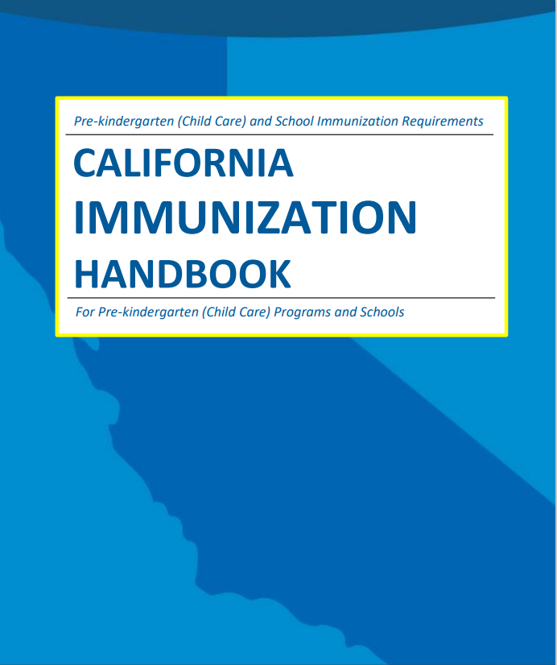
Other Special Situations
Dose given too early:
If the dose date is before Earliest Dose May be Given date, the dose still counts.
Oral polio vaccine (OPV) and international students:
Doses of OPV given on or after April 1, 2016, do not count. The student must show proof of inactivated polio vaccine (IPV).
Instructors: See the notes section for more information.
Notes:
These topics can be covered with more advanced groups or skipped for beginners.
Intervals too small (example: 3rd Hep B dose for student admitted conditionally was given too early): If a dose is given before the earliest dose may be given date on the conditional admission schedule, it still counts towards the requirement. See California Immunization Handbook pages 10-11 for additional details about which doses to check the timing of.
For international students, any doses of OPV given on or after April 1, 2016, do not count. The student must show proof of IPV. Referenced on pages 9 and 11 of the CA Immunization Handbook and the childcare guides.

Slide 59
CDPH.ca.gov/ShotsForSchool
Instructors: See the notes section for more information.
Notes:
You can find all the resources that we used in this training and more on the Shots For School website.
Most can be found by selecting the Tools for Schools section in the navigation, and the Guides, Blue Cards & More section.

Slide 60
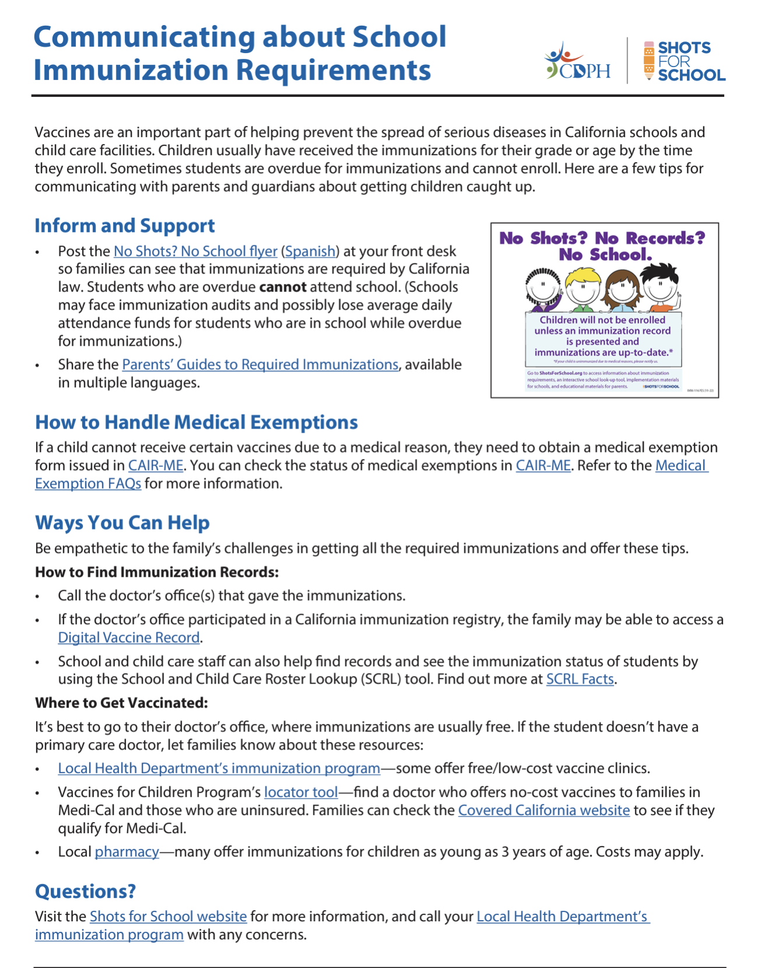
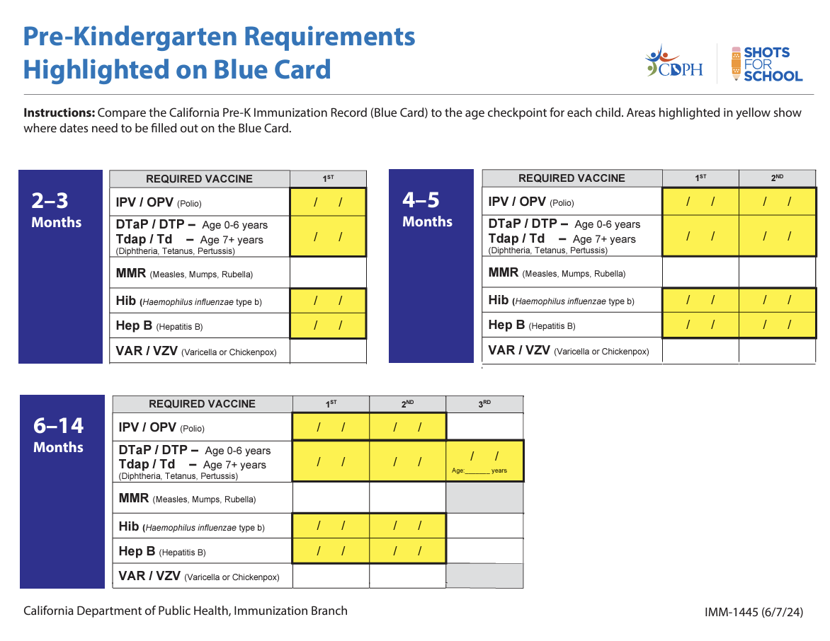
Resources
Instructors: See the notes section for more information.
Notes:
Resources include tips for communicating with parents about the immunization requirements and this job aid which highlights the number of doses that are required at all the age checkpoints.

Slide 61
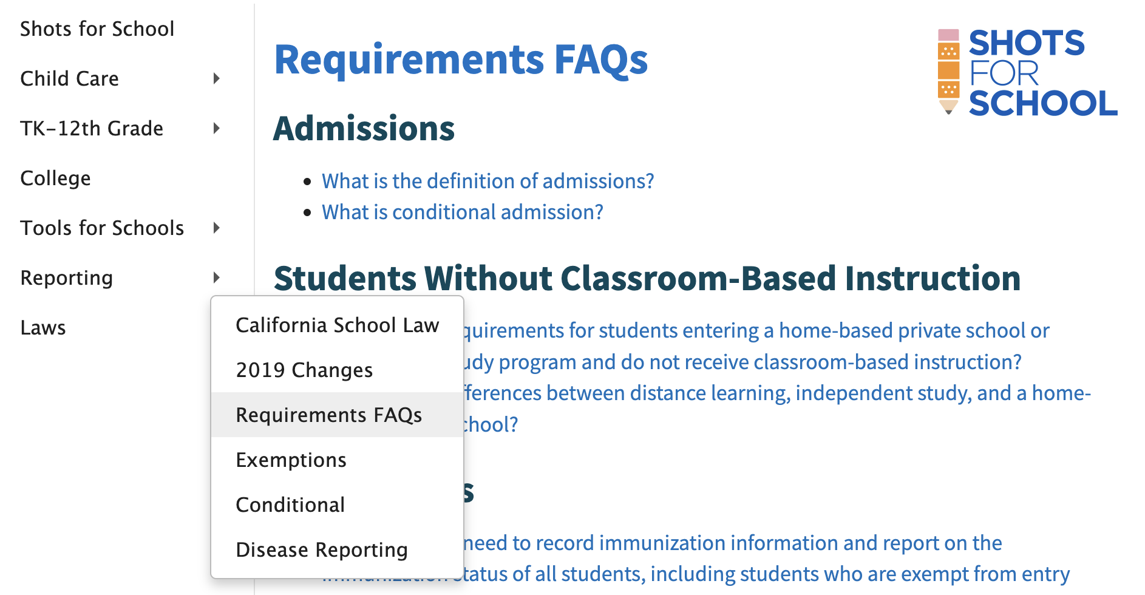
Answers
Send questions to [insert your email]
Instructors: See the notes section for more information.
Notes:
If you need more answers,
check out the California Immunization Handbook in the Tools for School section, or
You can also check the FAQs in the Laws section of the Shots for School website or
Send me an email (instructor: fill in the email on the slide with your local contact) or
Email Shotsforschool@cdph.ca.gov

Slide 62
Other Helpful Websites
Check medical exemptions at: CAIR-ME.CDPH.CA.gov
Determine if a student meets all immunization requirements using the School & Child Care Roster Lookup (SCRL): CAIRhub.CDPH.CA.gov

Slide 63
Thank You!

